Slide 1

Grazing angle study on Malta2 test beam 2024
L. Gonella, T. Inada, L. Li , A. Vijay,
09/05/2024

Slide 2
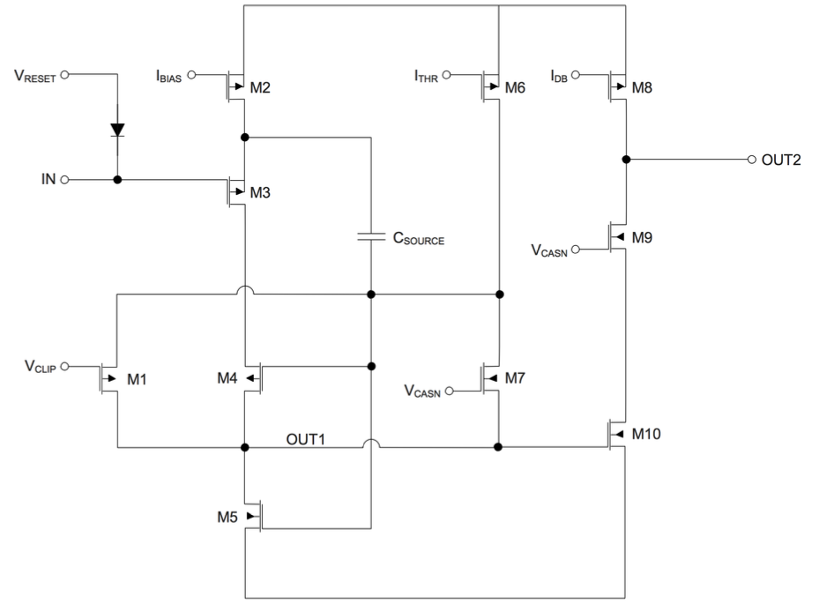
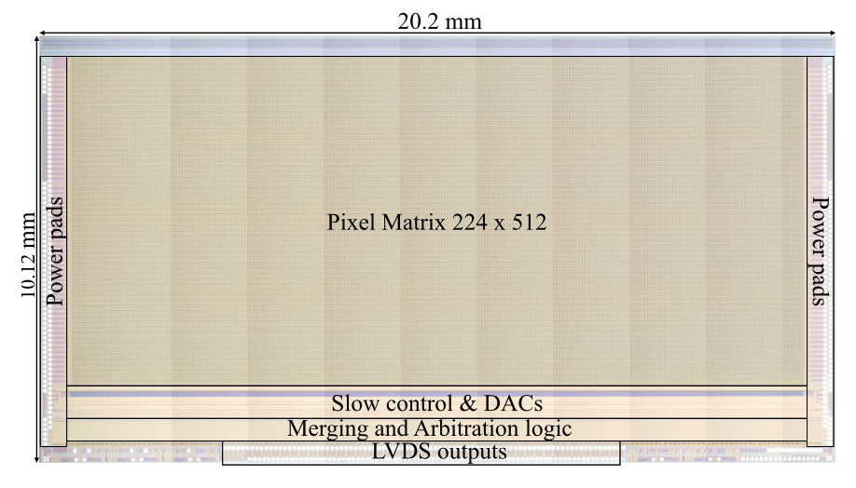
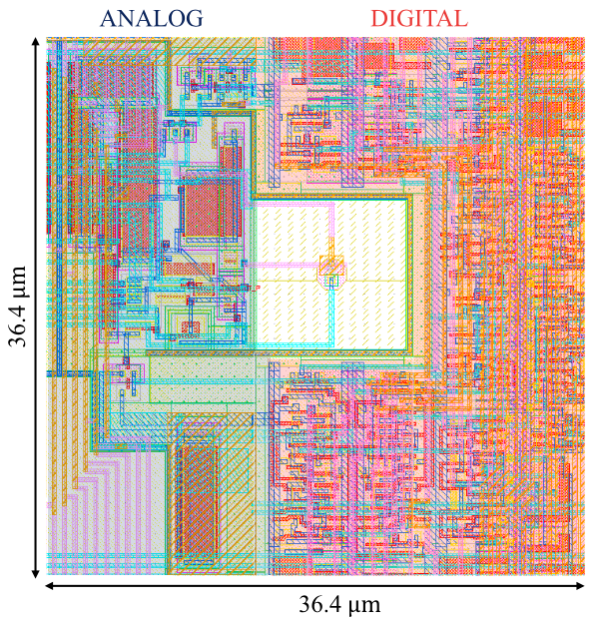
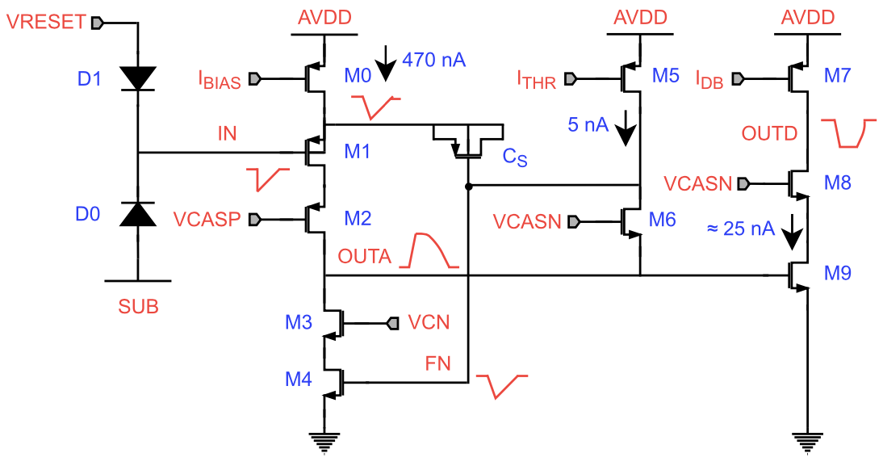
Malta: A candidate for outmost Tracker layer on HL-LHC
Malta
Malta series is designed for the outmost tracker layer on HL-LHC
Radiation hardness: 3e^15 1MeV neq/cm2 + 100MRad
T-J 180 nm imaging process (Modified)
Pixel matrix: 512*512(Malta), 224*512(Malta)
Pixel pitch: 36.4um*36.4um
M1 and M4 were modifed in size, which is mean source of RTS noise.
Malta2
MALTA read-out & testing

Slide 3
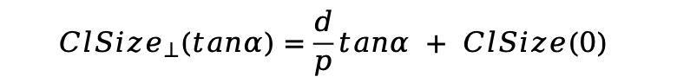
Depletion depth study using grazing angle method
p
α
A typical degradation of sensor performance after irradiation is the decrease of the depletion depth. This could be studied by inclined track at SPS using 180 GeV hadron.
d
cluster size projected on the axis perpendicular to the axis of rotation
d = p(clsizealpha - clsize0)/tanalpha
$${ClSize}_{⊥}(tanα)=\frac{d}{p}tanα + ClSize(0)$$
MALTA read-out & testing

Slide 4
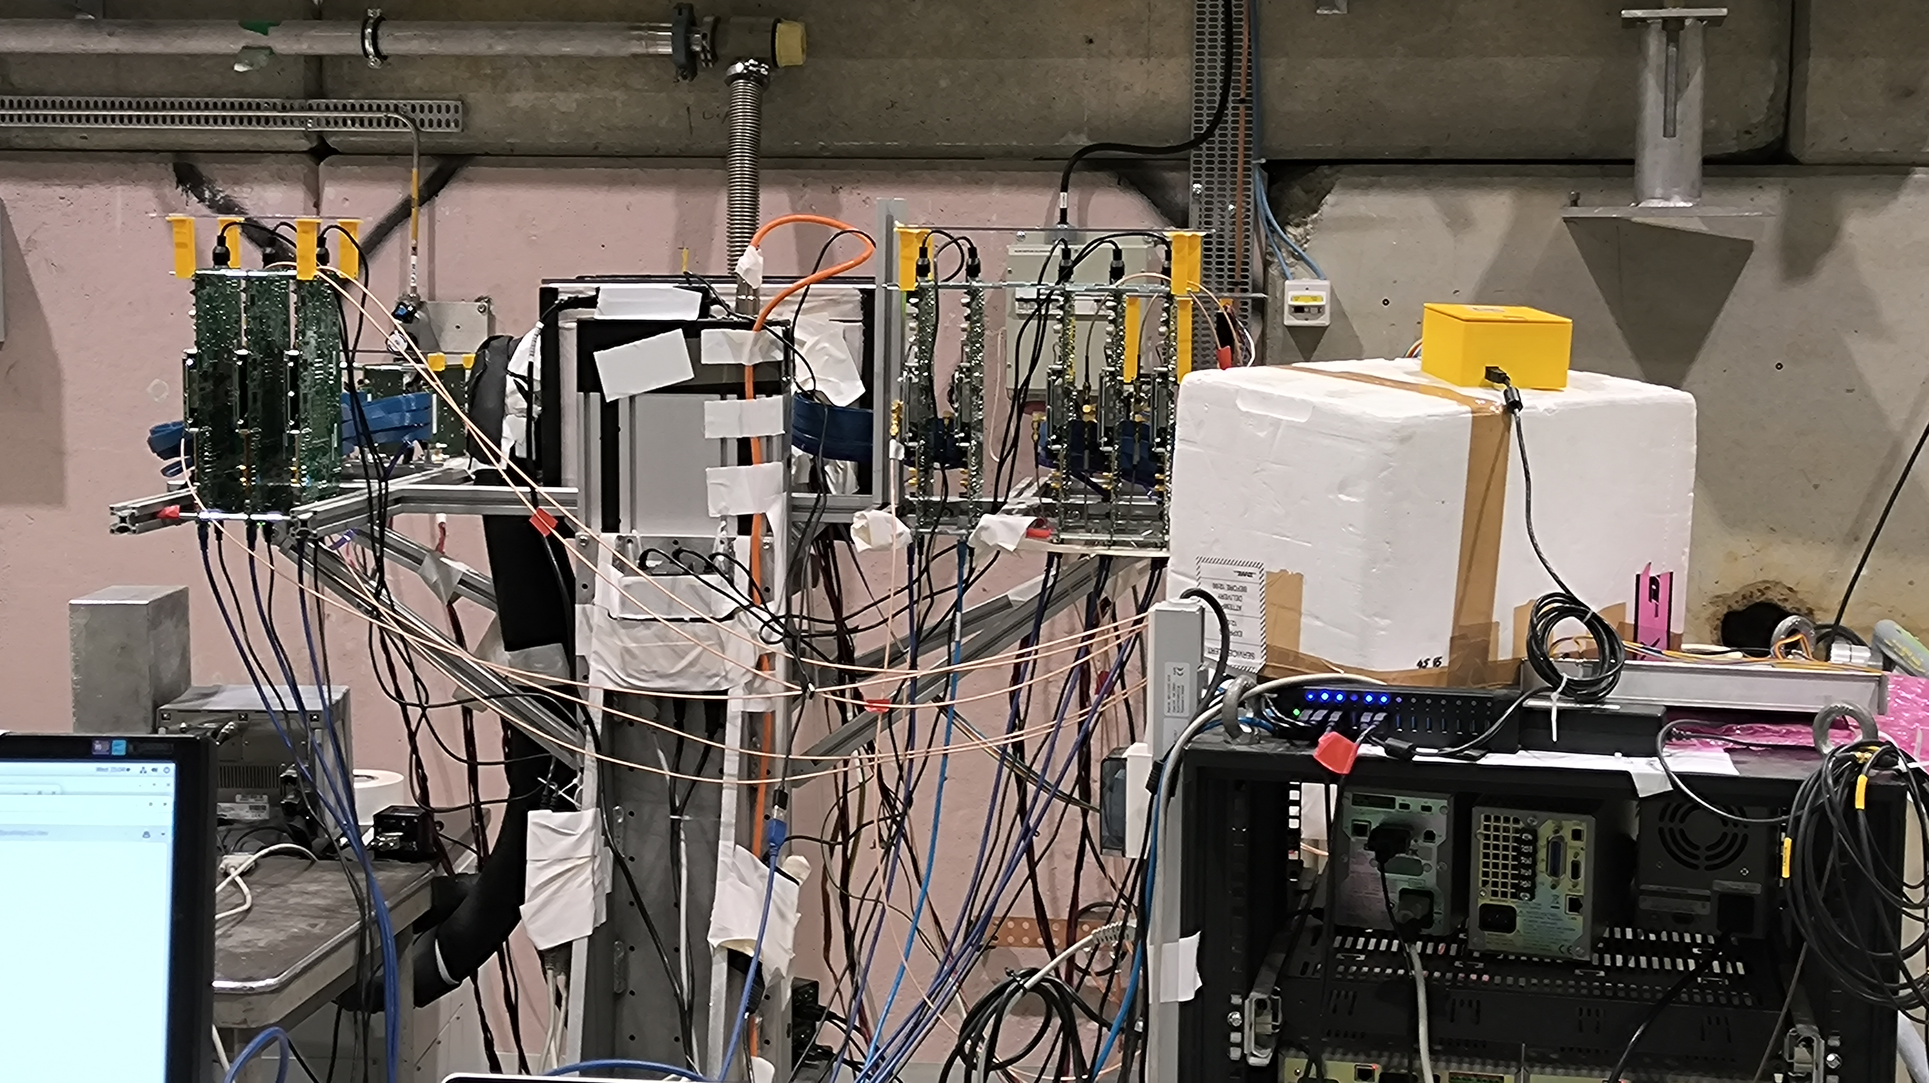
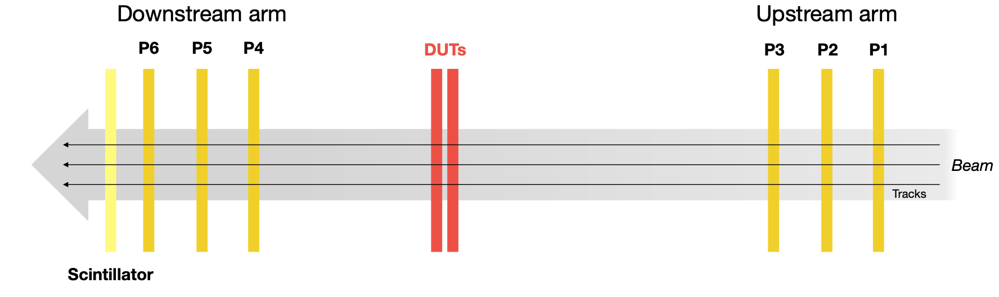
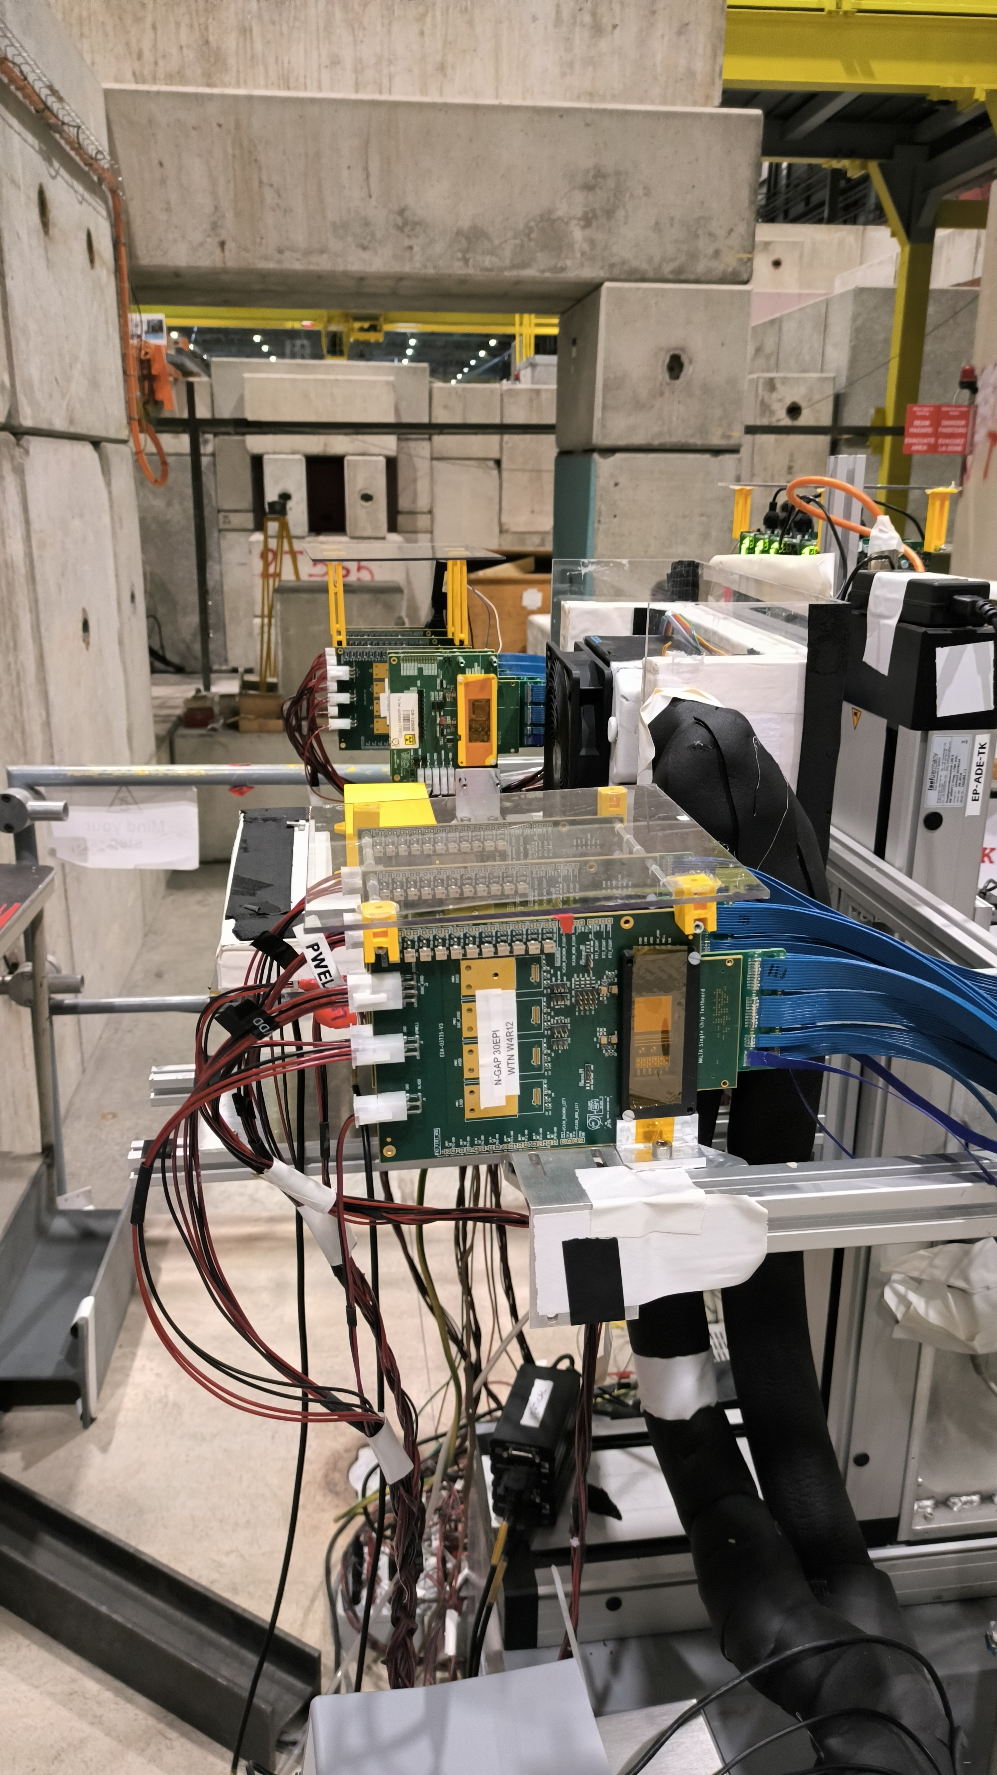
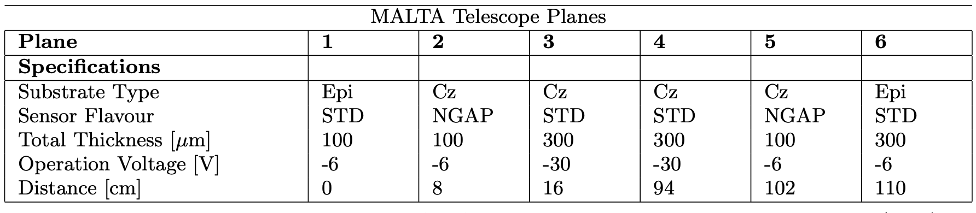
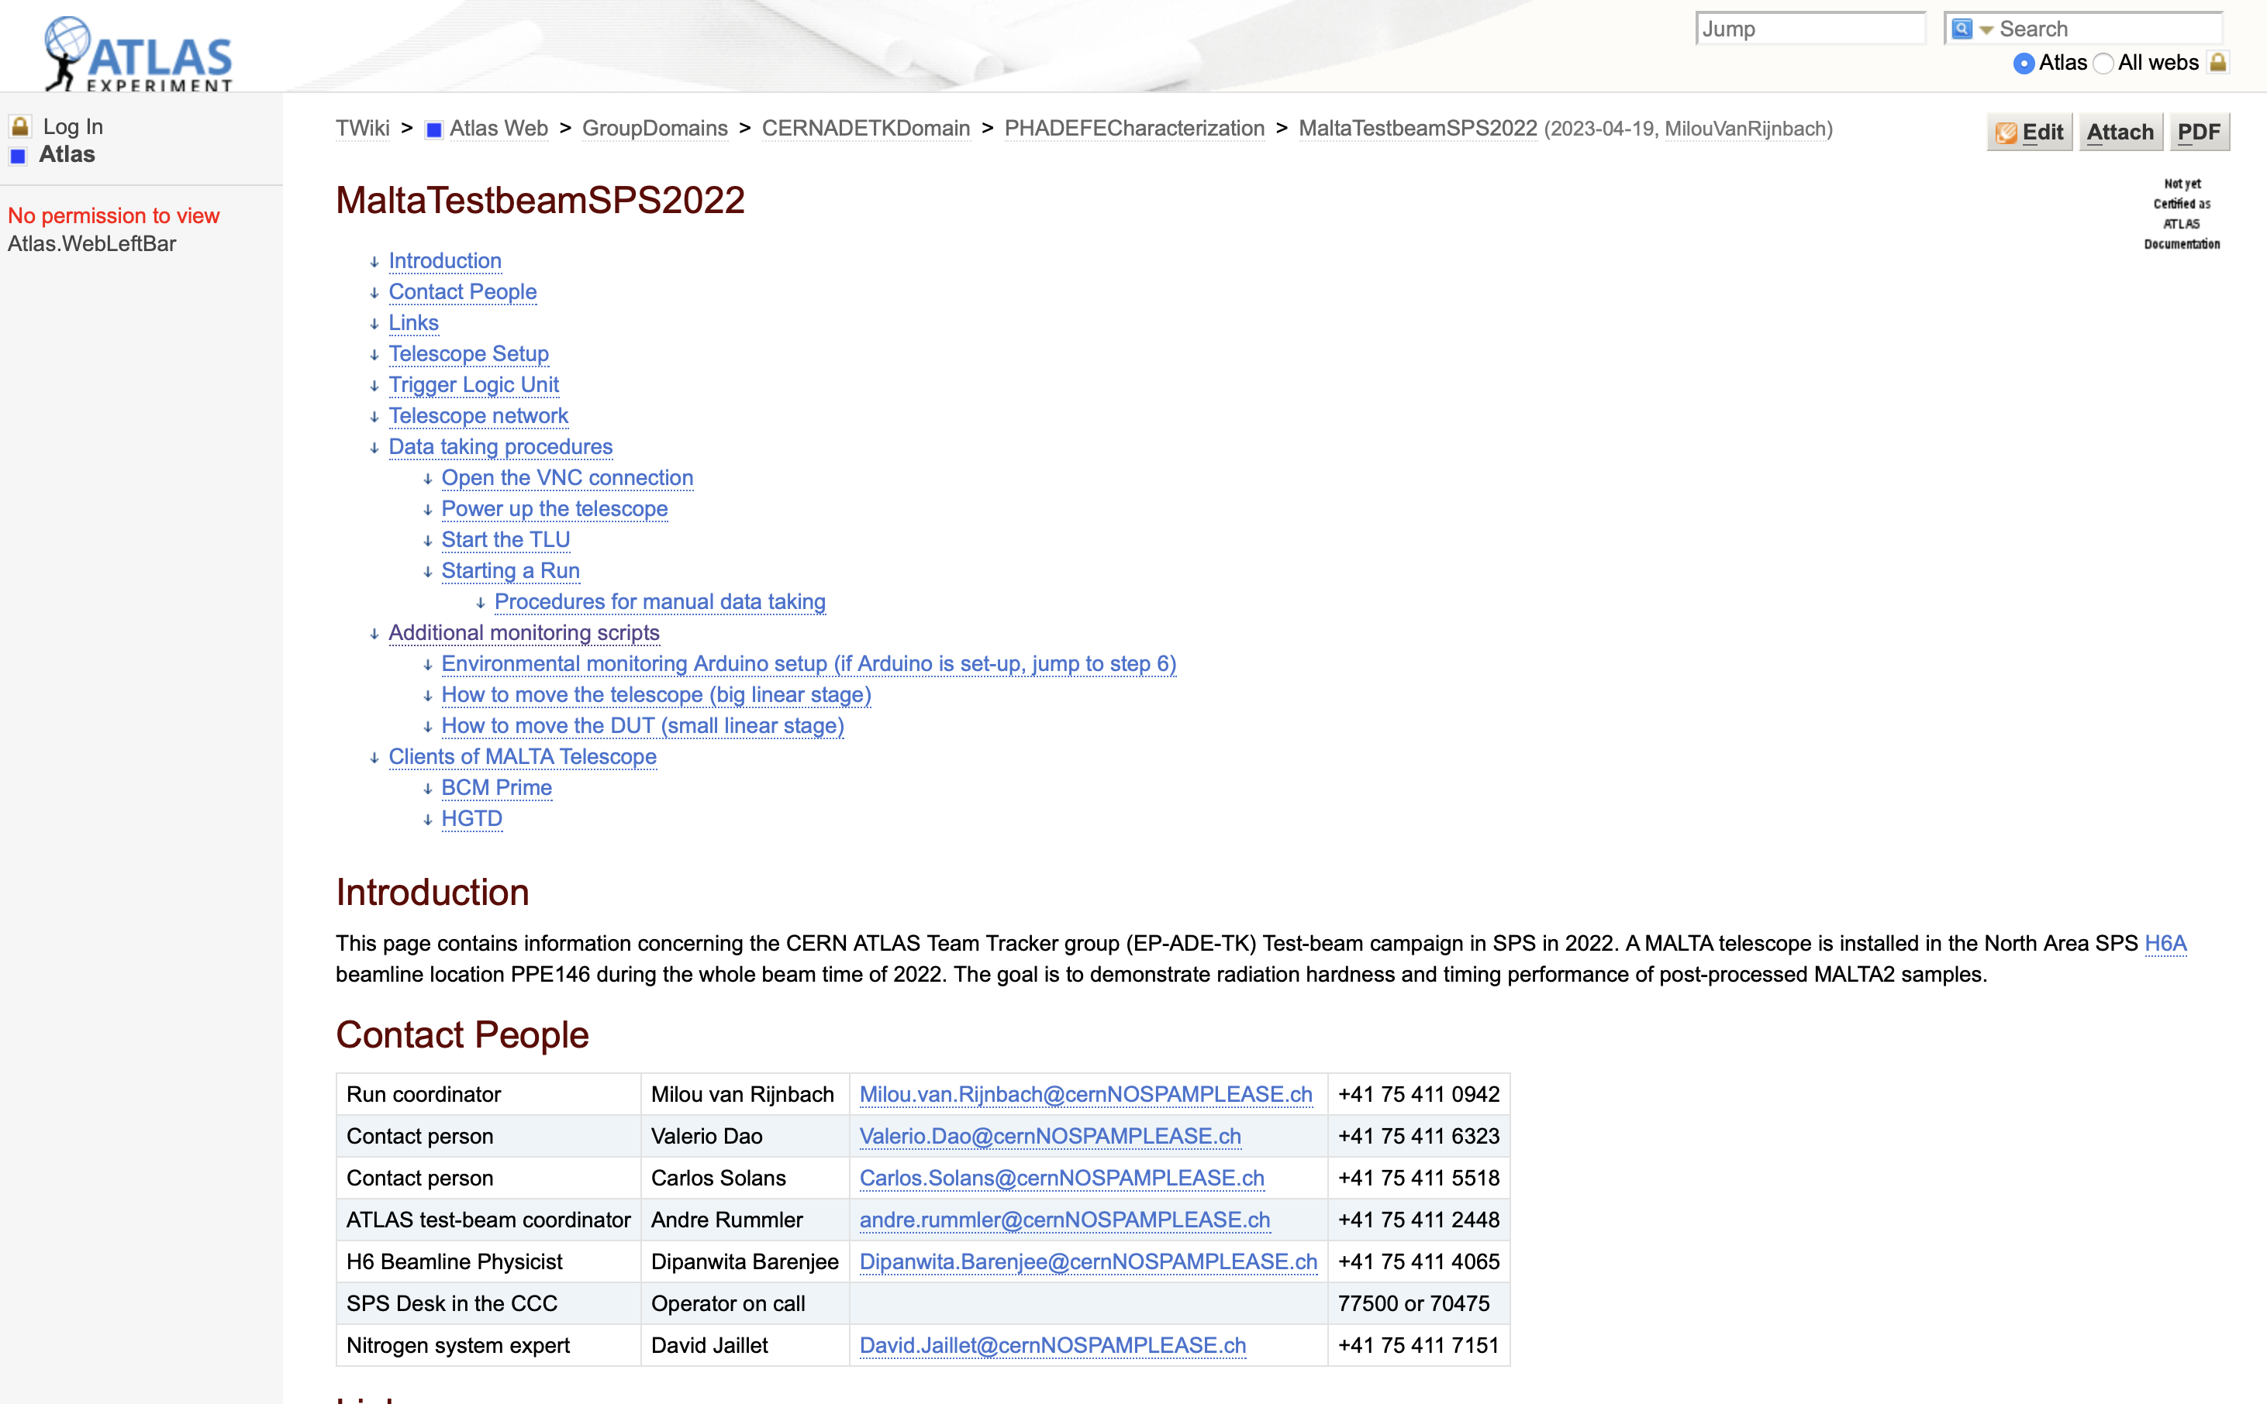
Malta telescope
Twiki
MALTA read-out & testing

Slide 5
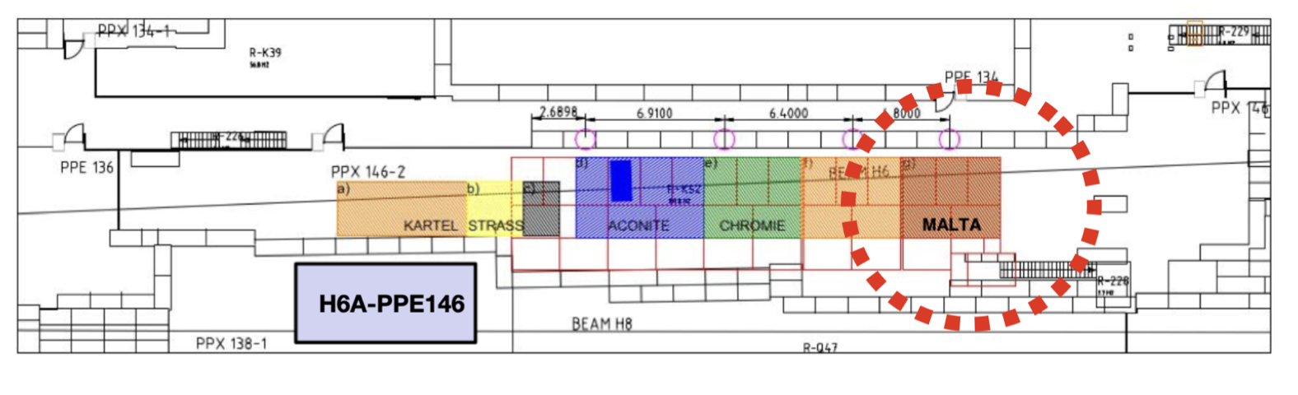
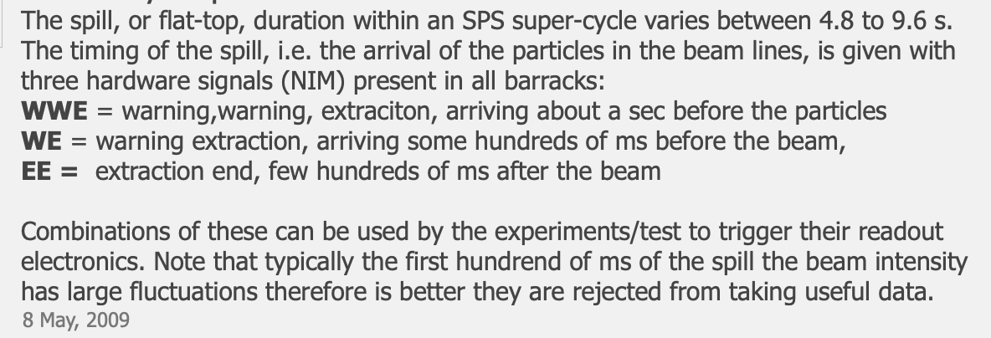
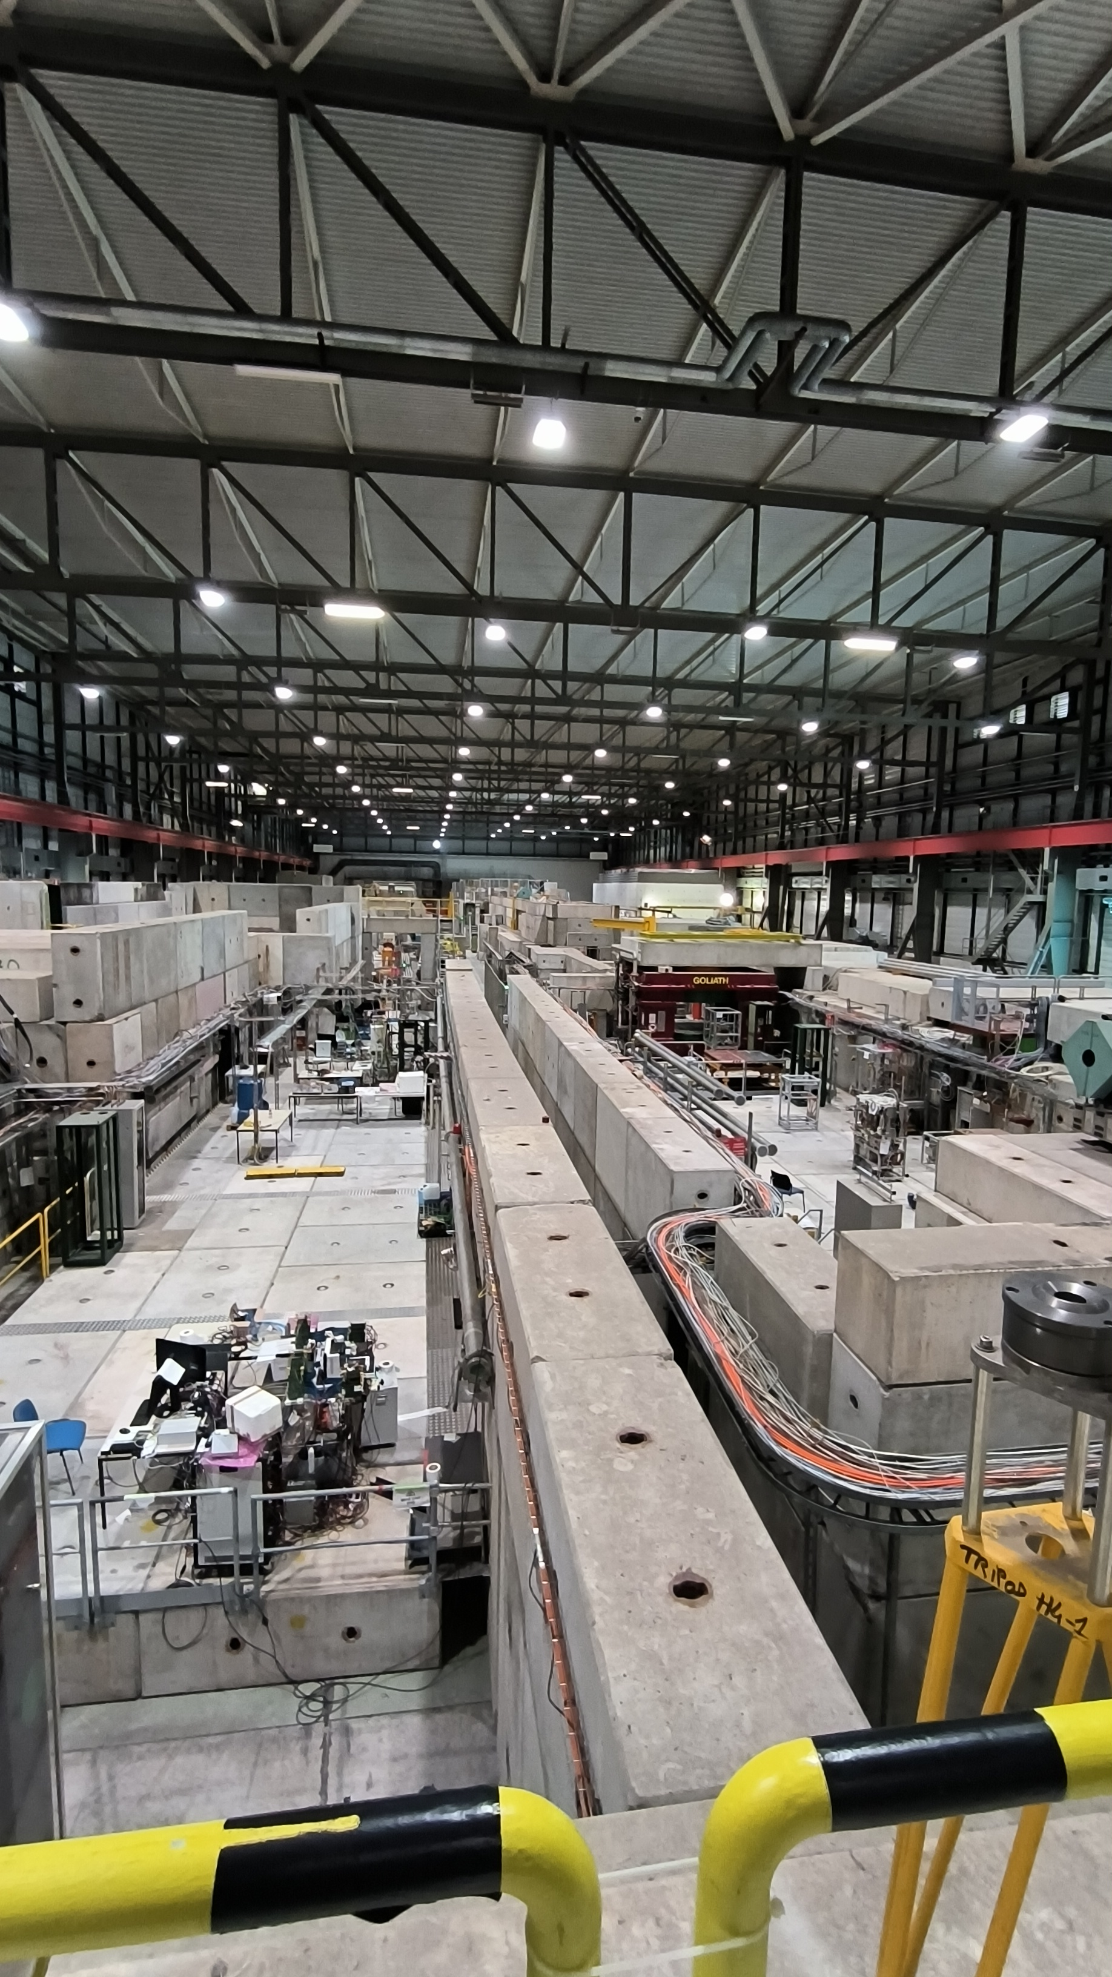
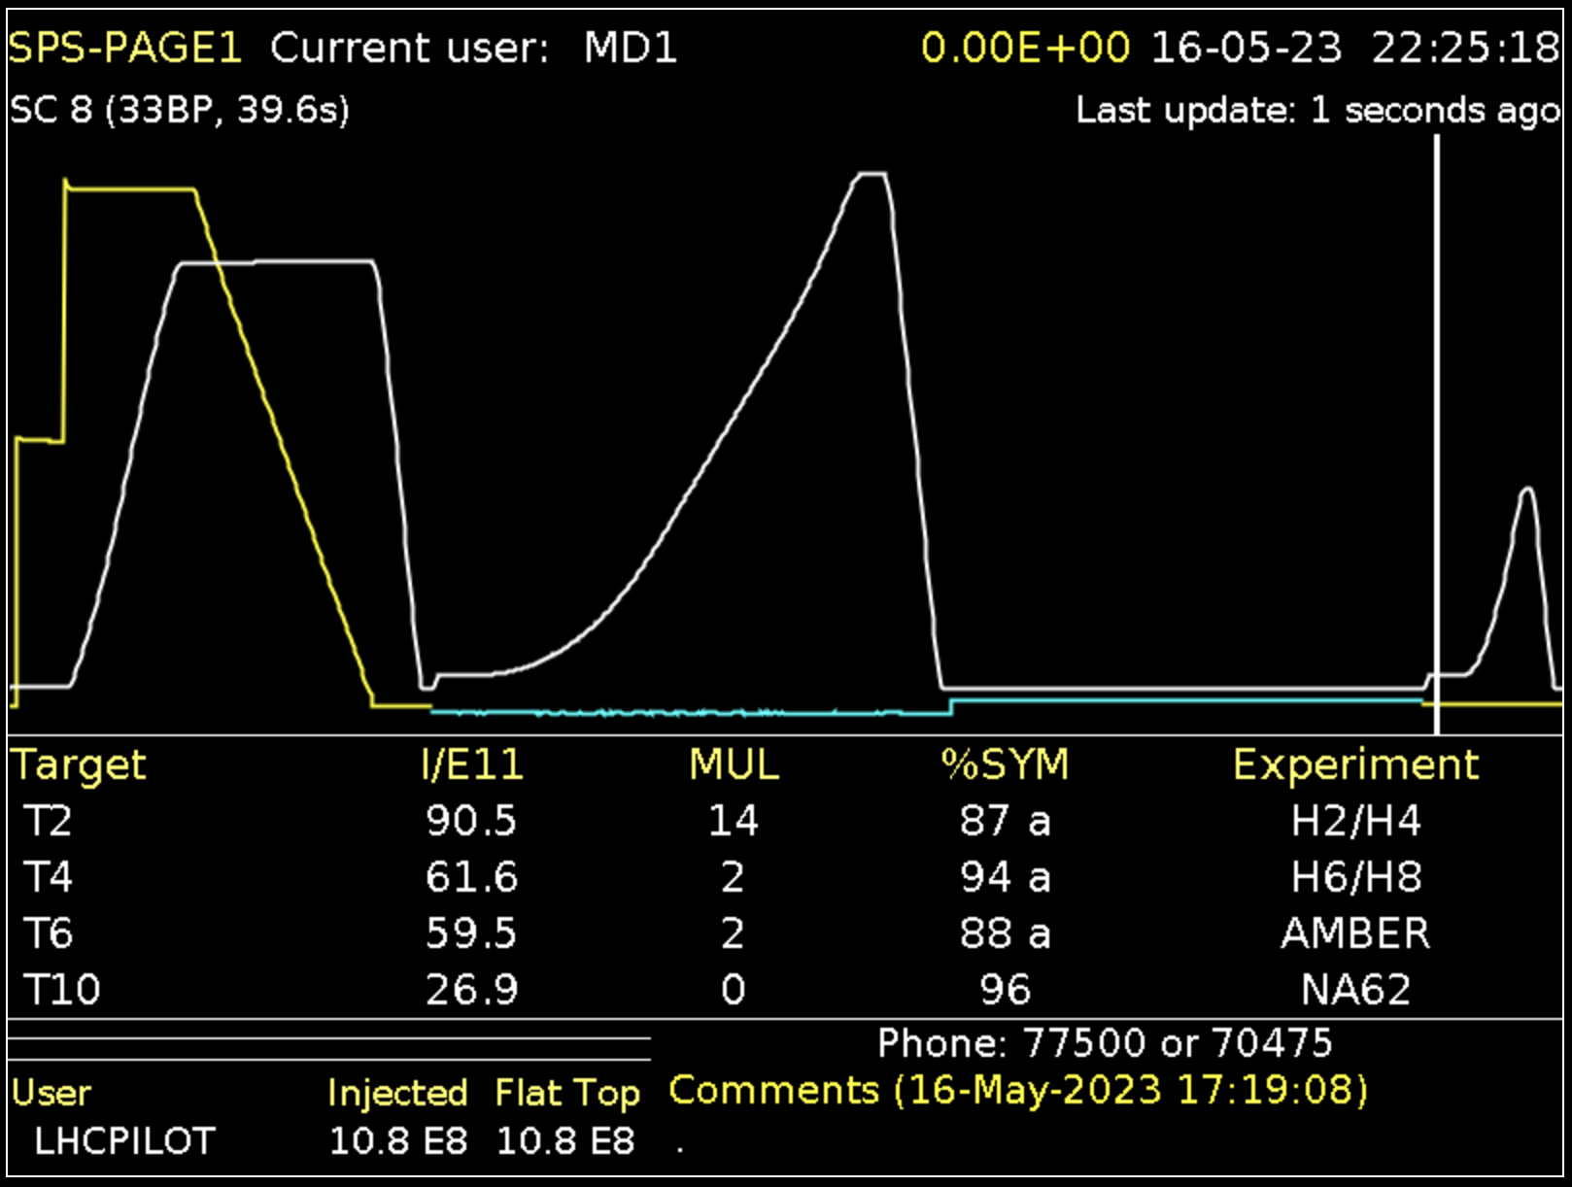
Test beam Info
Mixed hadron beams within the range of 10-205 GeV/c.
Intensity: between 2×10^5 and 4.5×10^6 par- ticles per spill.
Beam monitor
Beam quality
H6
MALTA read-out & testing

Slide 6
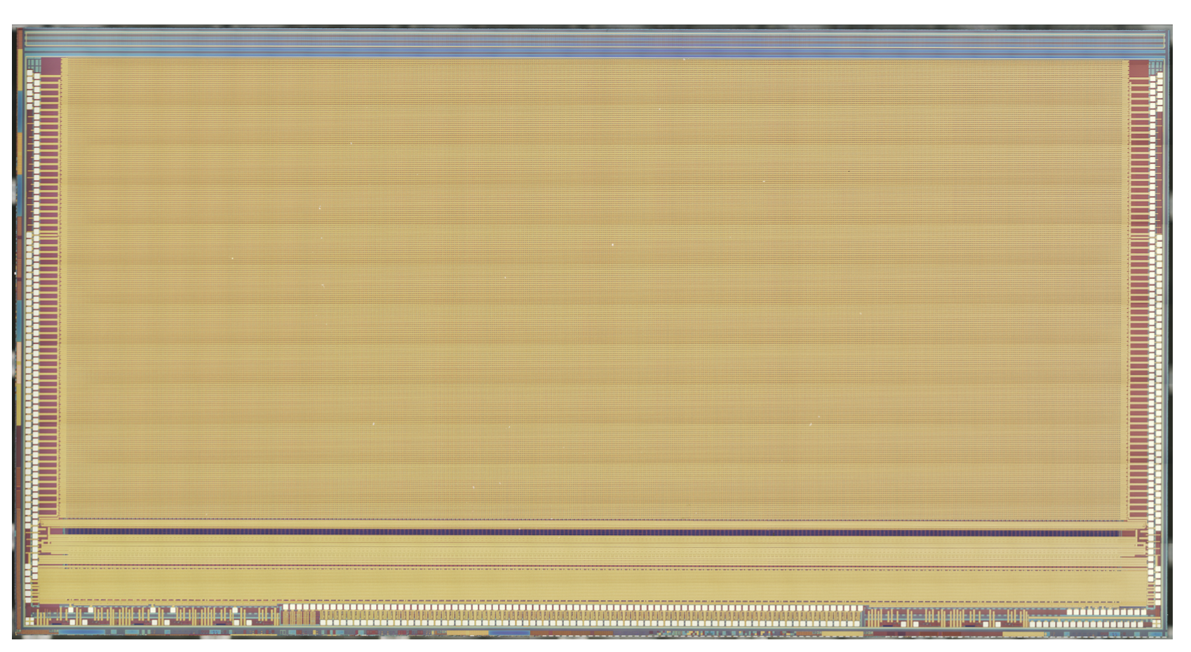
DUT info
Test setup
all other settings are by default.
operating temperature: -12~-15C
relative humidity: < 1%
name | value
Vsub | 6, 9, 15, 20, 25, 30 [V]
ITHR | 15, 20, 40, 80, 120 [pA]
Deg | 30, 35, 40, 45, 50, 55, 60
Malta2 sensor
Technology: TJ-180
chip size: 20.2x10.1168 mm^2
Matrix: 224x512 pixels
pixel size: 36.4x36.4um^2
DUT sensor: W12R7
Cz back matelized
thickness: 300 um
Irradiated 1E15 neq
ITHR SUB DEG
015 20.0 60.0
015 25.0 60.0
015 30.0 60.0
020 25.0 60.0
020 30.0 60.0
040 25.0 60.0
040 30.0 60.0
080 25.0 60.0
080 30.0 60.0
120 25.0 60.0
120 30.0 60.0
11 data point missed during
data taking
MALTA read-out & testing

Slide 7
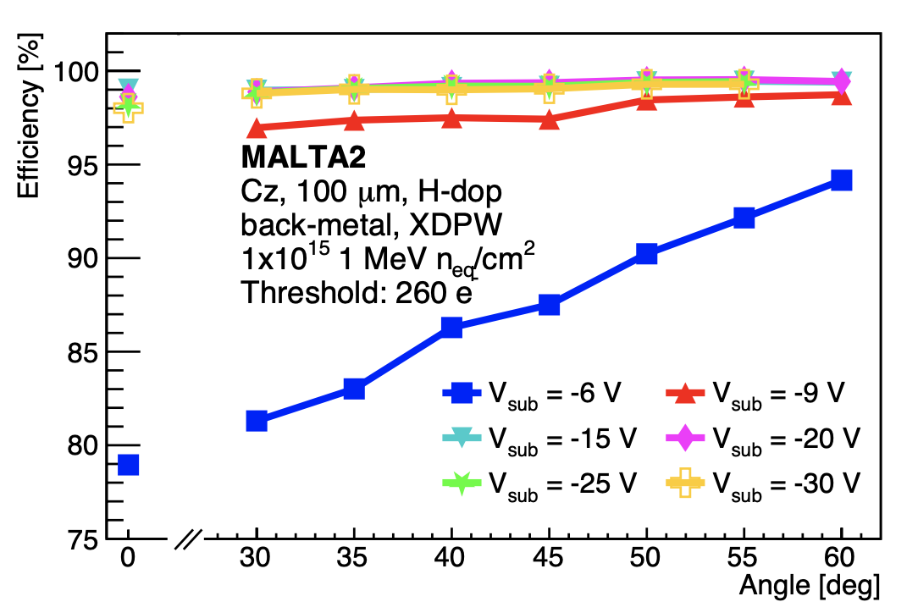
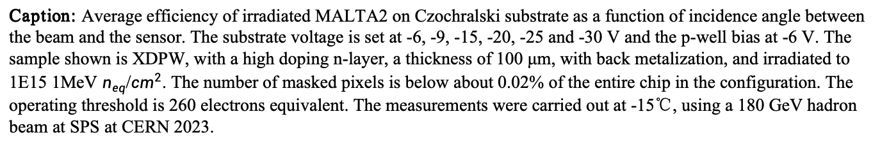
Efficiency vs. inclined angle
Caption: Average efficiency of irradiated MALTA2 on Czochralski substrate as a function of incidence angle between the beam and the sensor. The substrate voltage is set at -6, -9, -15, -20, -25 and -30 V and the p-well bias at -6 V. The sample shown is XDPW, with a high doping n-layer, a thickness of 100 μm, with back metalization, and irradiated to 1E15 1MeV $n_{eq}$/${cm}^{2}$. The number of masked pixels is below about 0.02% of the entire chip in the configuration. The operating threshold is 260 electrons equivalent. The measurements were carried out at -15℃, using a 180 GeV hadron beam at SPS at CERN 2023.
MALTA read-out & testing

Slide 8
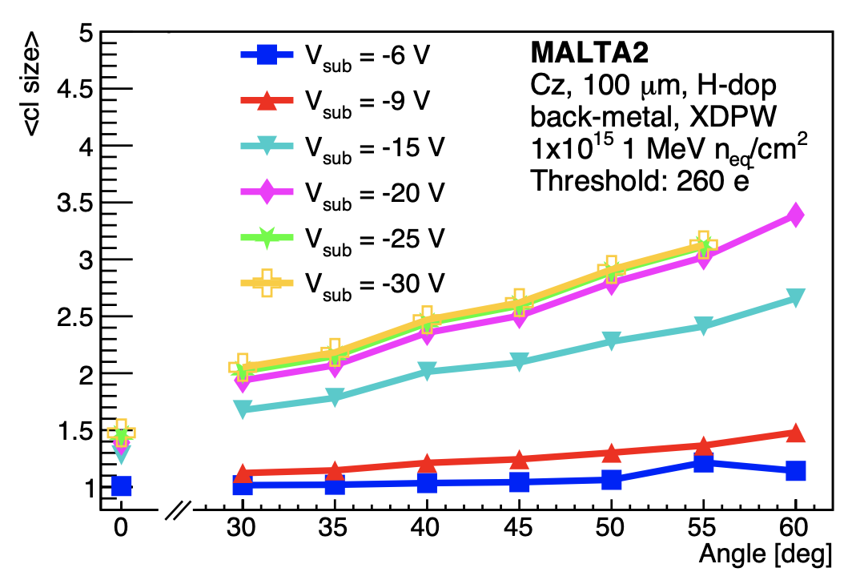
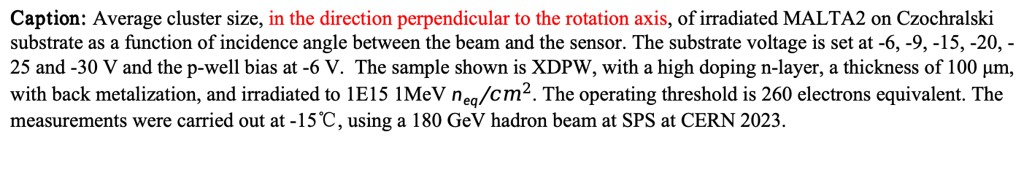
Clsize vs. inclined angle
Caption: Average cluster size, in the direction perpendicular to the rotation axis, of irradiated MALTA2 on Czochralski substrate as a function of incidence angle between the beam and the sensor. The substrate voltage is set at -6, -9, -15, -20, -25 and -30 V and the p-well bias at -6 V. The sample shown is XDPW, with a high doping n-layer, a thickness of 100 μm, with back metalization, and irradiated to 1E15 1MeV $n_{eq}$/${cm}^{2}$. The operating threshold is 260 electrons equivalent. The measurements were carried out at -15℃, using a 180 GeV hadron beam at SPS at CERN 2023.
MALTA read-out & testing

Slide 9
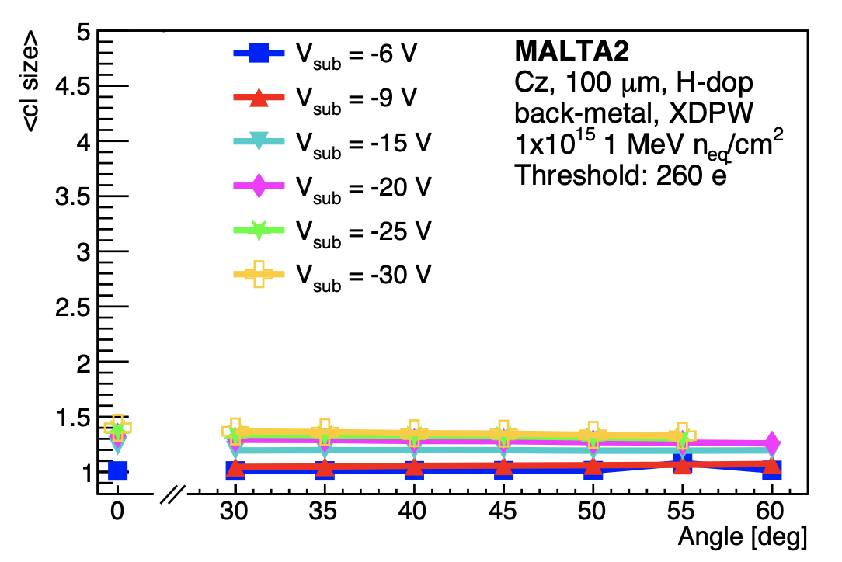
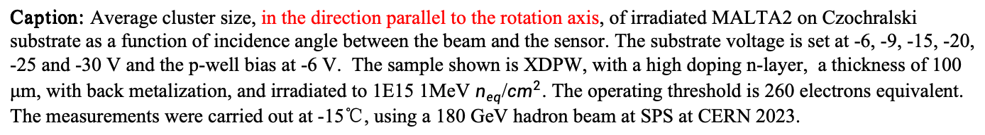
ClsizeY vs. inclined angle
Caption: Average cluster size, in the direction parallel to the rotation axis, of irradiated MALTA2 on Czochralski substrate as a function of incidence angle between the beam and the sensor. The substrate voltage is set at -6, -9, -15, -20, -25 and -30 V and the p-well bias at -6 V. The sample shown is XDPW, with a high doping n-layer, a thickness of 100 μm, with back metalization, and irradiated to 1E15 1MeV $n_{eq}$/${cm}^{2}$. The operating threshold is 260 electrons equivalent. The measurements were carried out at -15℃, using a 180 GeV hadron beam at SPS at CERN 2023.
MALTA read-out & testing

Slide 10
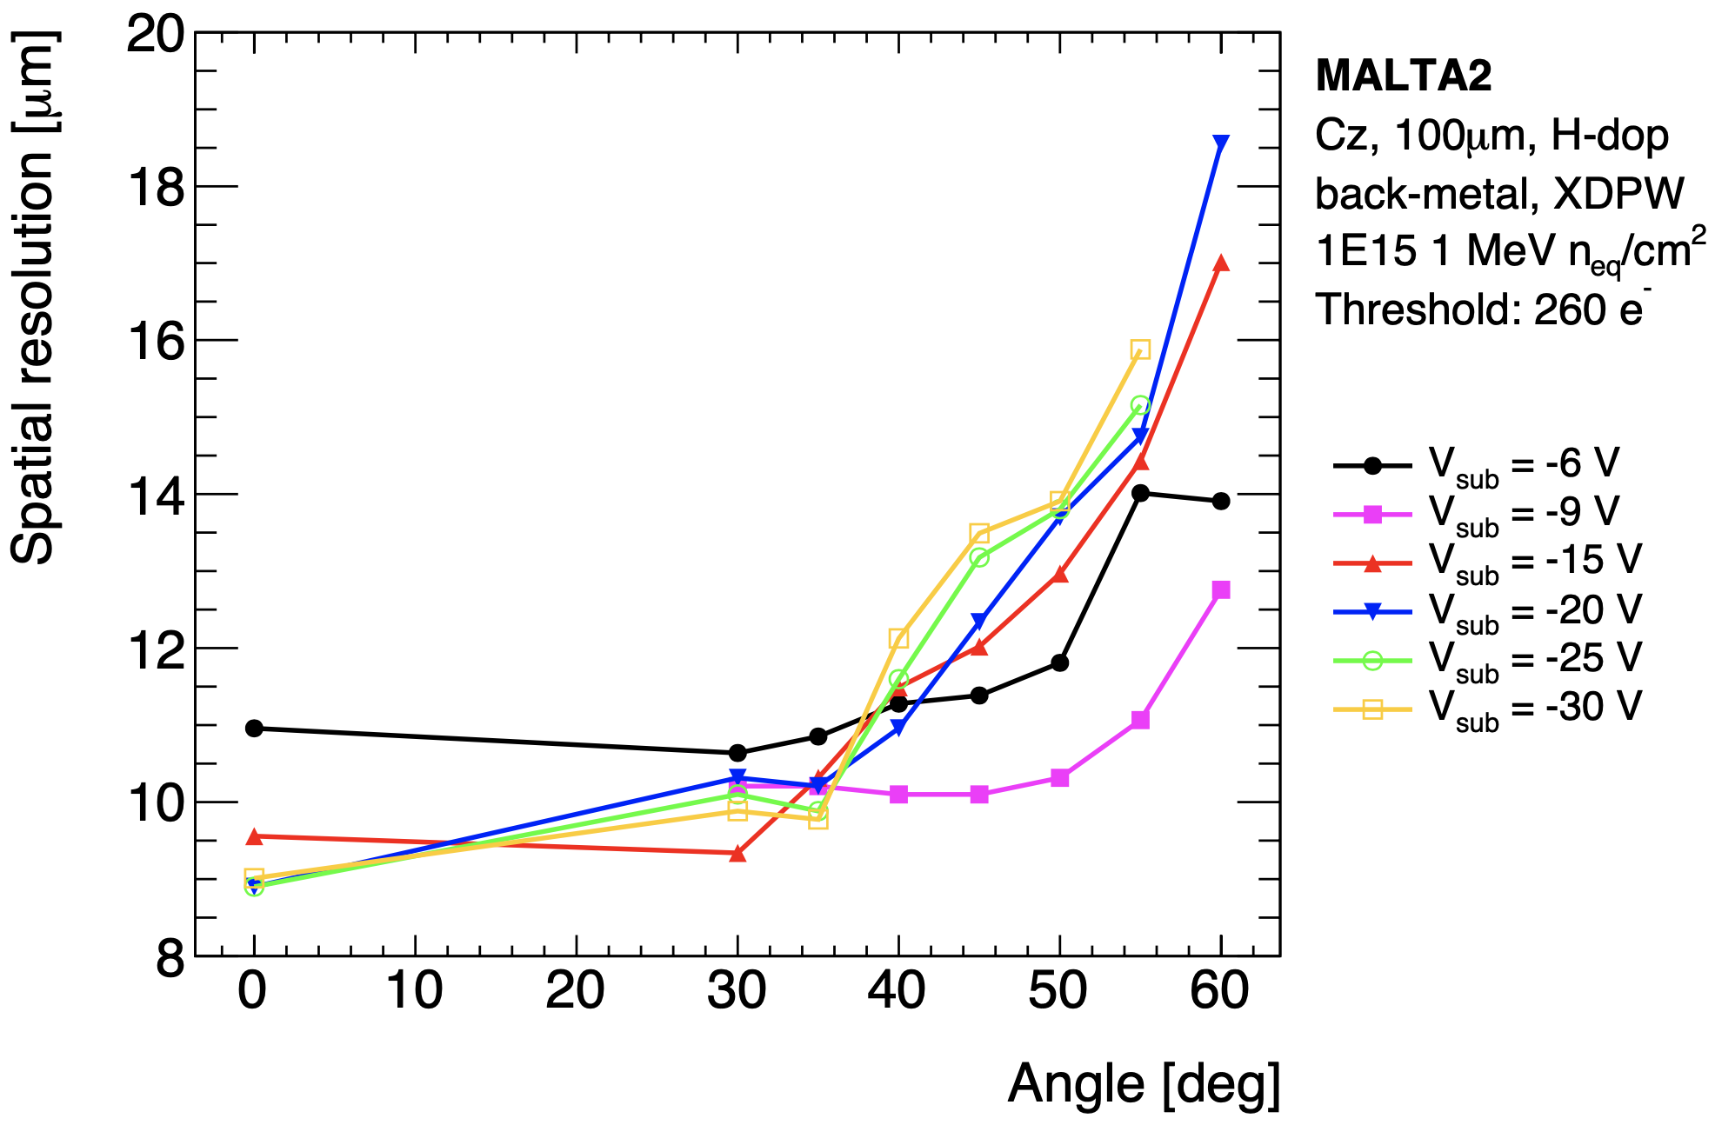
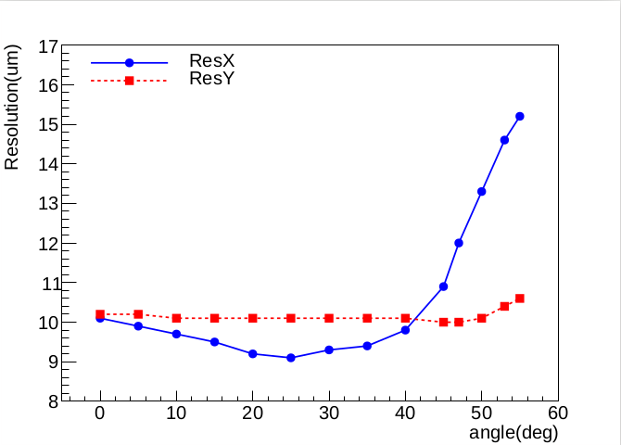
$σ_{DUT}$ of W8R20, Vsub 6V, ITHR025(170 electrons)
For ${RMS}_{residual}$, it decreases against inclined angle then increases, and the turning point is 25 deg. Unfortunately, we miss the lower angle than 30 deg last August.
MALTA read-out & testing

Slide 11
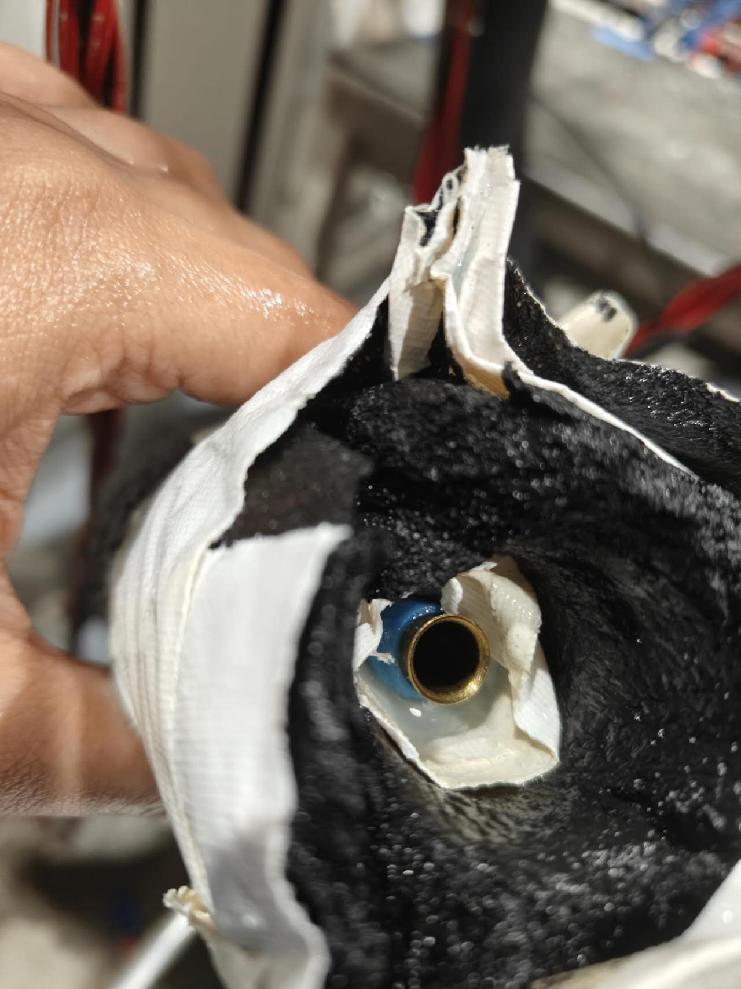
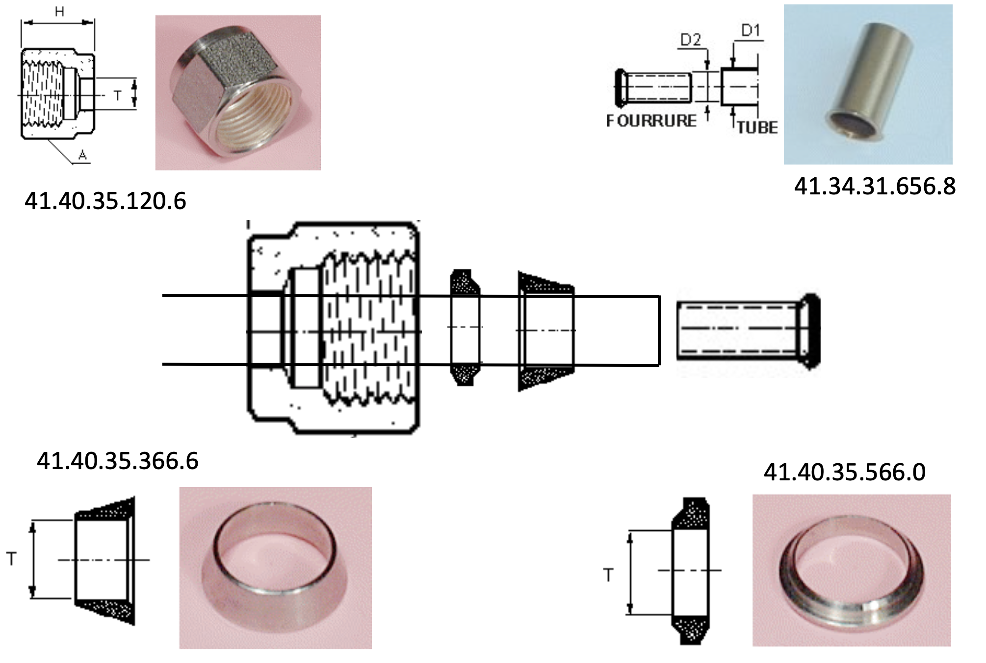
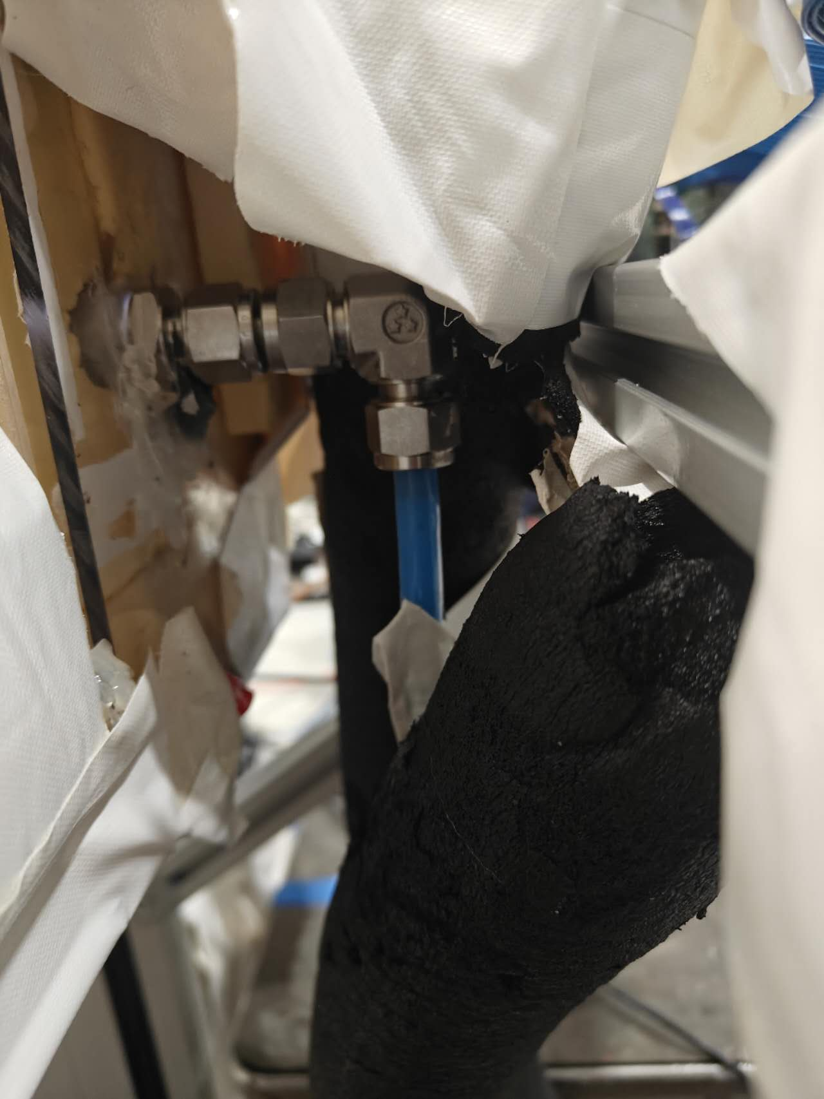
Reference planes check: liquid leaking of chiller
- Liquid leaks from the coldbox/pipe connection.
- Pipe escaped from the nut
- solved by re-installation.
- no dropping for the moment, need further check with longer run.
MALTA read-out & testing

Slide 12
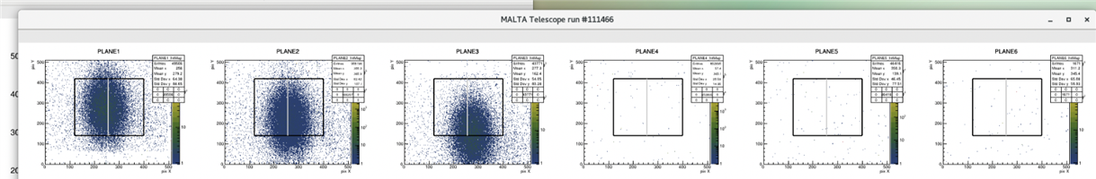
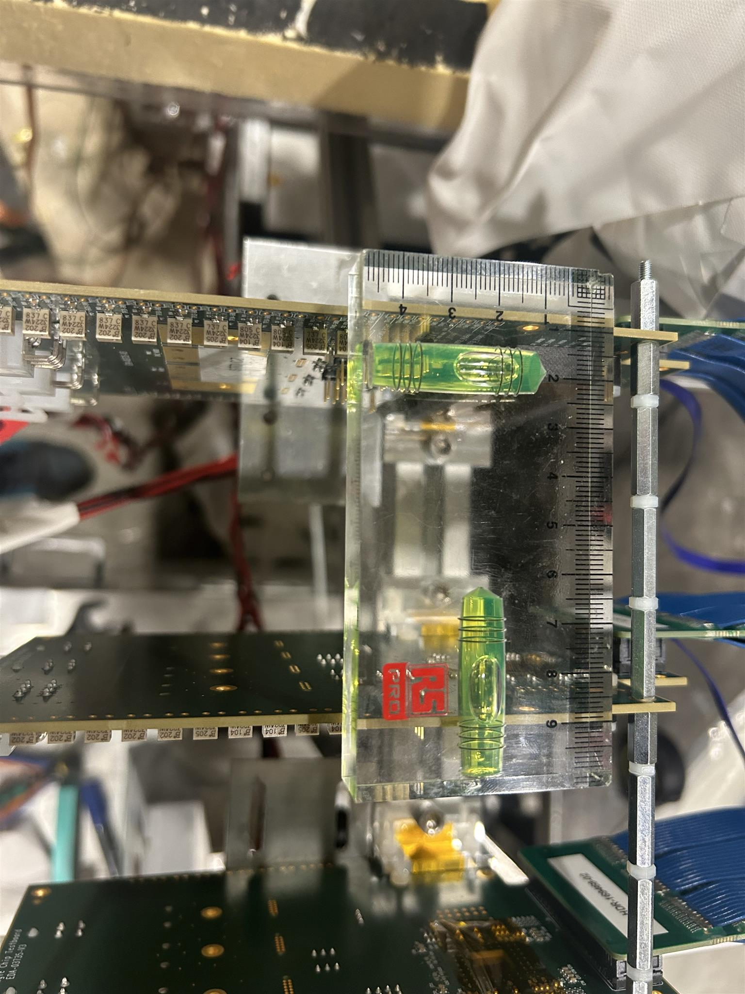
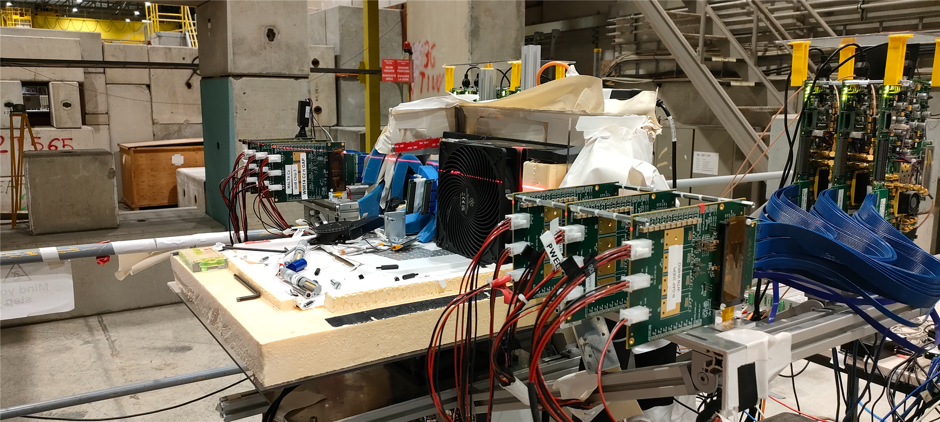
Reference planes check: mis-alignment
Out of beam area because of x mis-alignment
plane 1, 2 &3:
- mis-alignment both in X and Y orientation.
- planes tilt along Z-axis
up-stream/down stream wings:
- linear stage tilts along X-axis, plane 1, 2 & 3 are higher than plane 4, 5 & 6
MALTA read-out & testing

Slide 13
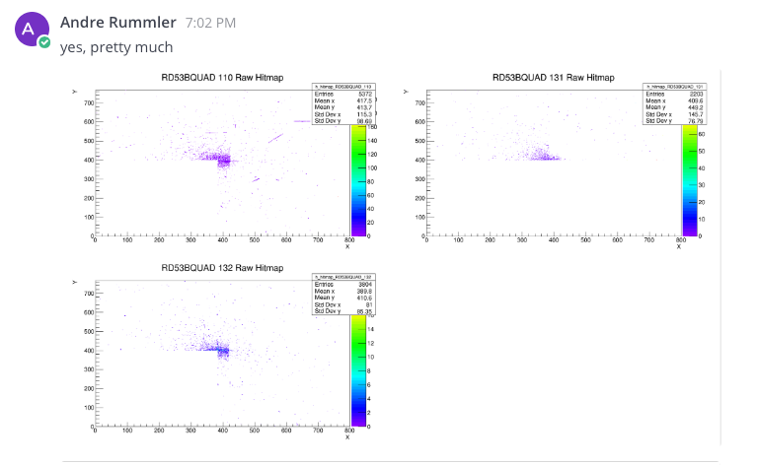
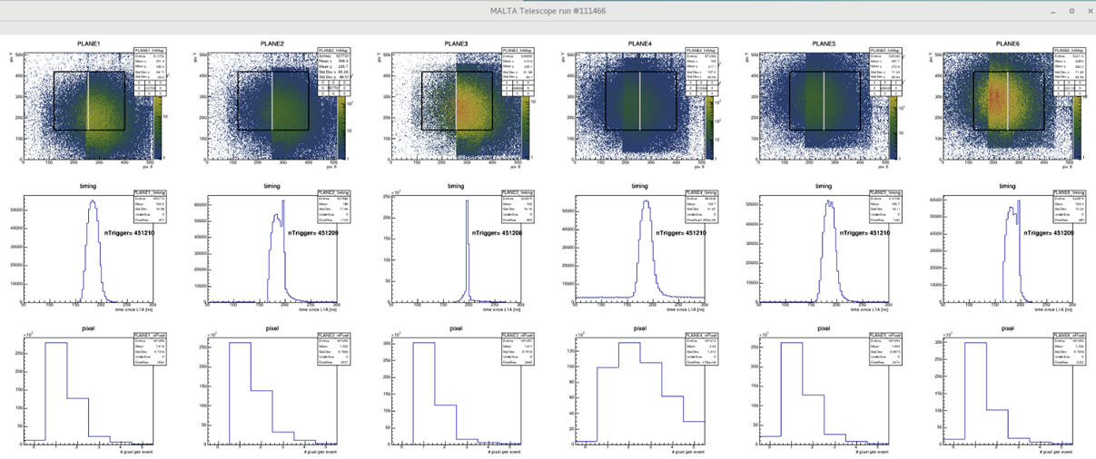
Hit map after alignment using laserliner
- Better performance after the alignment.
- Could do it more precisly manully, should the mis-alignment affect the tracking? (offline alignment verified)
- asymmetry found, might be related to the beam issue.
MALTA read-out & testing

Slide 14
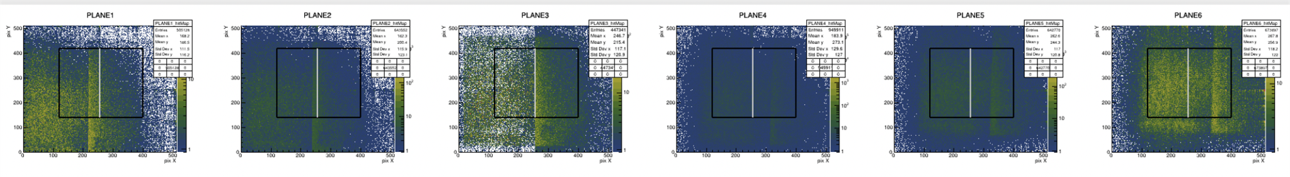
Hit Asymmetry on telescope planes
- The asymmetry is not the beam issue.
- It only happend when plane 3 was used for triggering.
- ununiformity of triggering between left and right part of plane (W7R12, Malta CZ)
- The asymmetry was already observed last August, Not understood yet, it could be solved by running some time.
MALTA read-out & testing

Slide 15
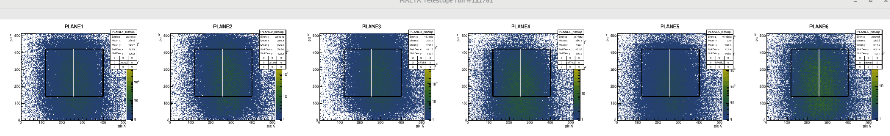
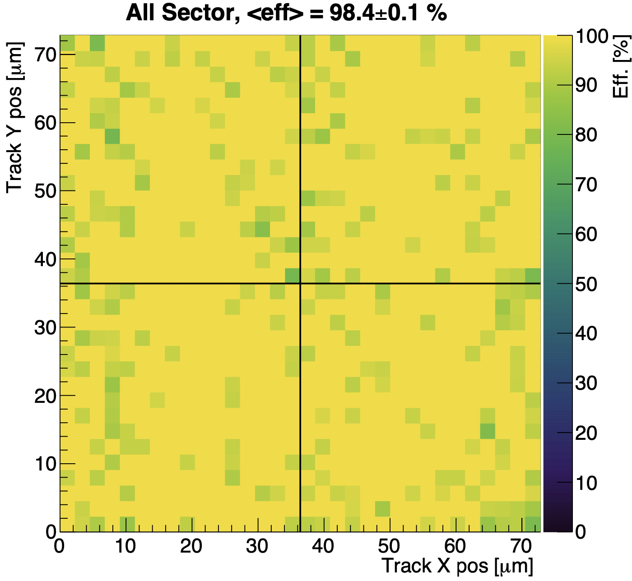
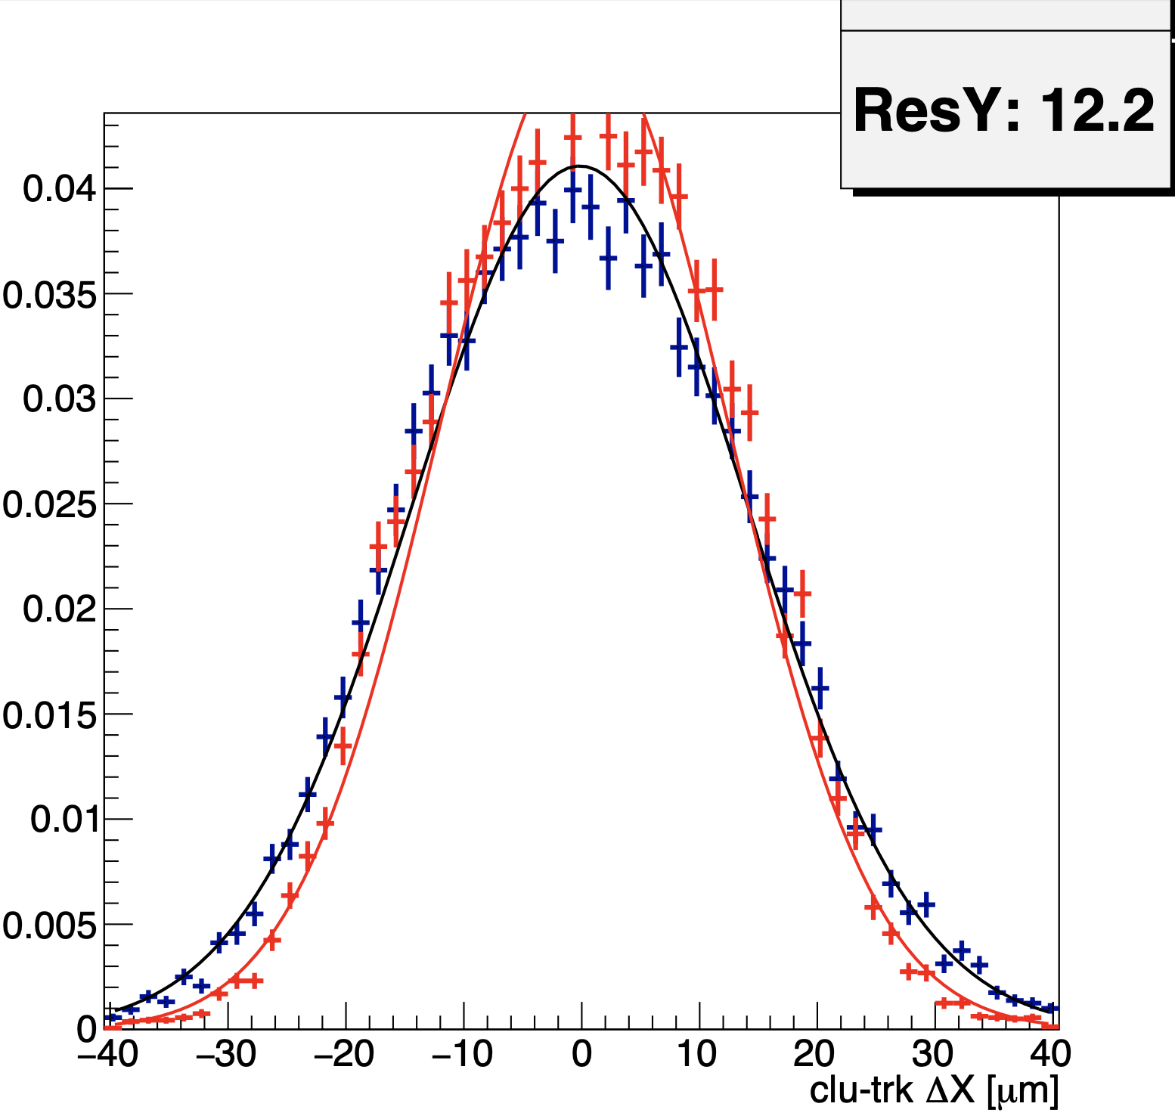
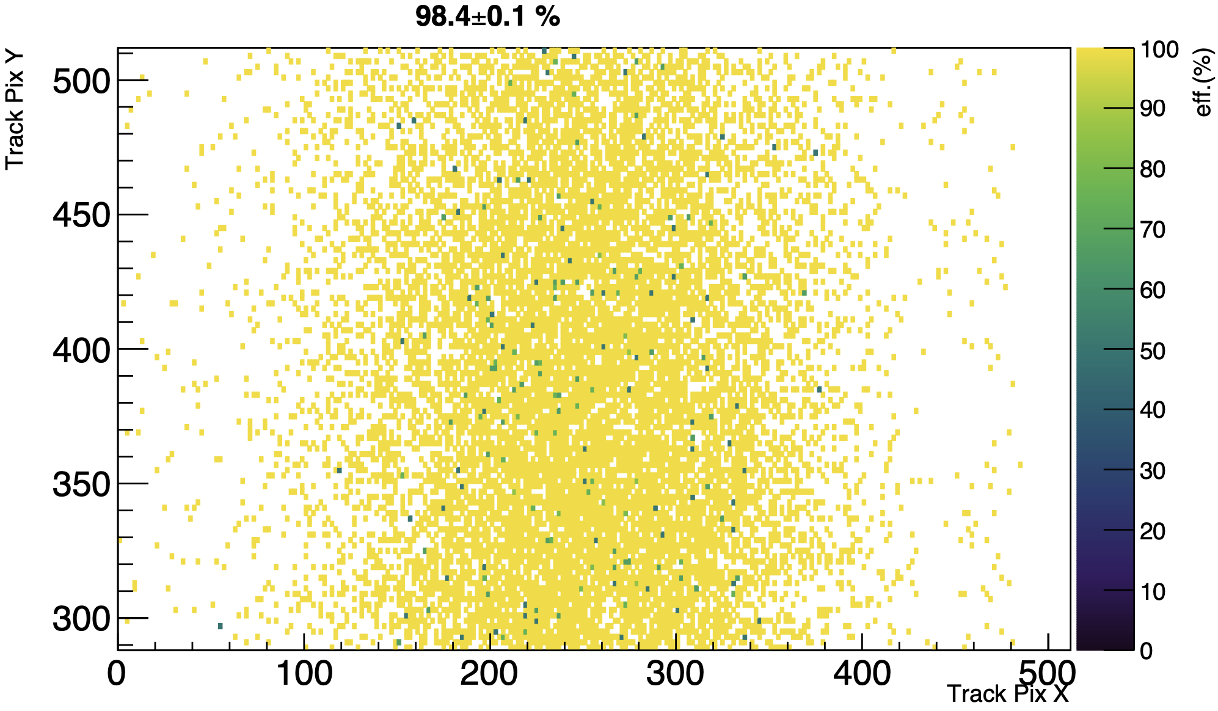
Alignment of telescope planes
- Alignment is much improved on 1st May.
- Mis-alignment is still there, could be deal with off-line alignment in MaltaTbAnalysis.
- Verified with sample (W15R19, Malta2 sensor without irradiation), ready for W12R7 data taking.
MALTA read-out & testing

Slide 16
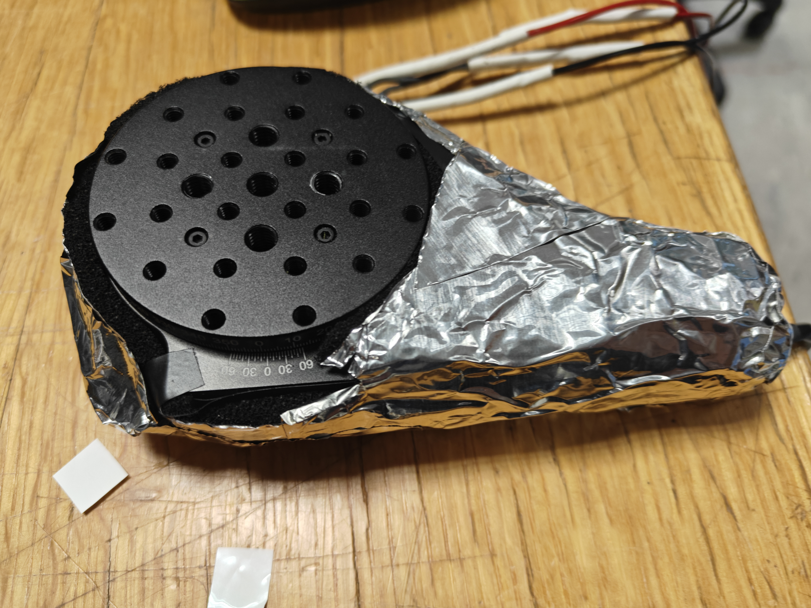
DUT status check: rotational stage
Issues we got in last Malta test beam:
- Motor overloaded when temperature is low (verified to be 5 ℃)
- Tried to warm the stage with heater, but the minimum temperature was 9.2 when heater was on. (The irradiated sensor should work when temperature < 15).
- Cover the stage with foam and aluminum foil, to prevent heat dissipating. Not working
start data taking
stop data taking
heat the coldbox
rotate the stage
cool the box down
- Plan to rotate at higher T and take data at lower T
remote T monitoring, ok
remote power control for heater, ok
remote power socket control for rotational stage, ok (in case overload)
- Drawbacks
Time consuming to cool down the box to - 15℃ many times
Call the data taking program at every single angle setting.
MALTA read-out & testing

Slide 17
DUT status check: mis-alignment on height between DUT and reference planes
- Will test the old one (yellow plastic ‘L’ holder), it worked in last Malta2 test beam.
- Print more ‘L’ holders for alternative.
MALTA read-out & testing

Slide 18
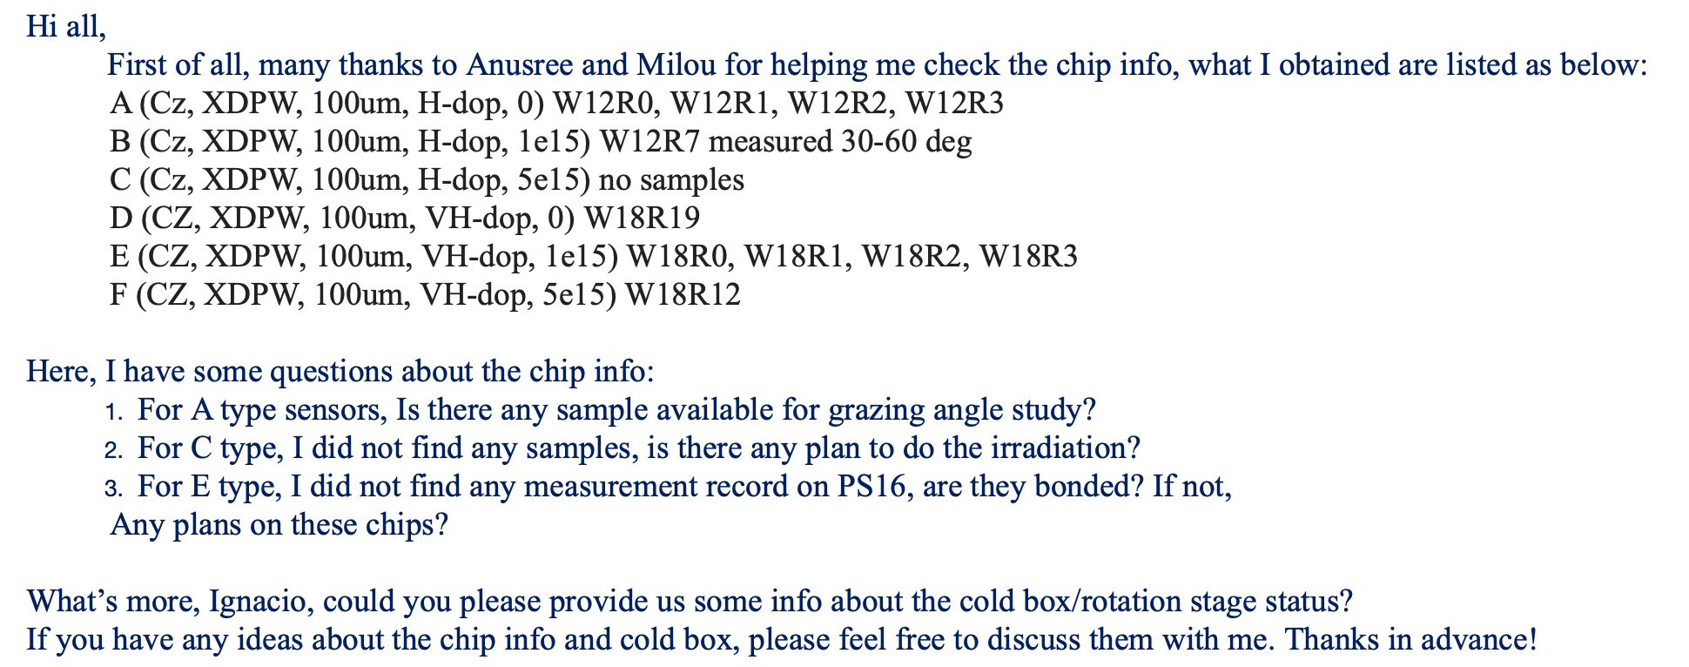
DUT status check: samples to be tested
plan to test as reference, W12R1 is bonded.
top priority
Test beam configurations for W12R7
parameters | value
ITHR | 15, 20, 40, 80, 120
SUB [-V] | 6, 9, 15, 20, 25, 30
Angle [deg] | 0, 5, 10, 15, 20, 25
MALTA read-out & testing

Slide 19
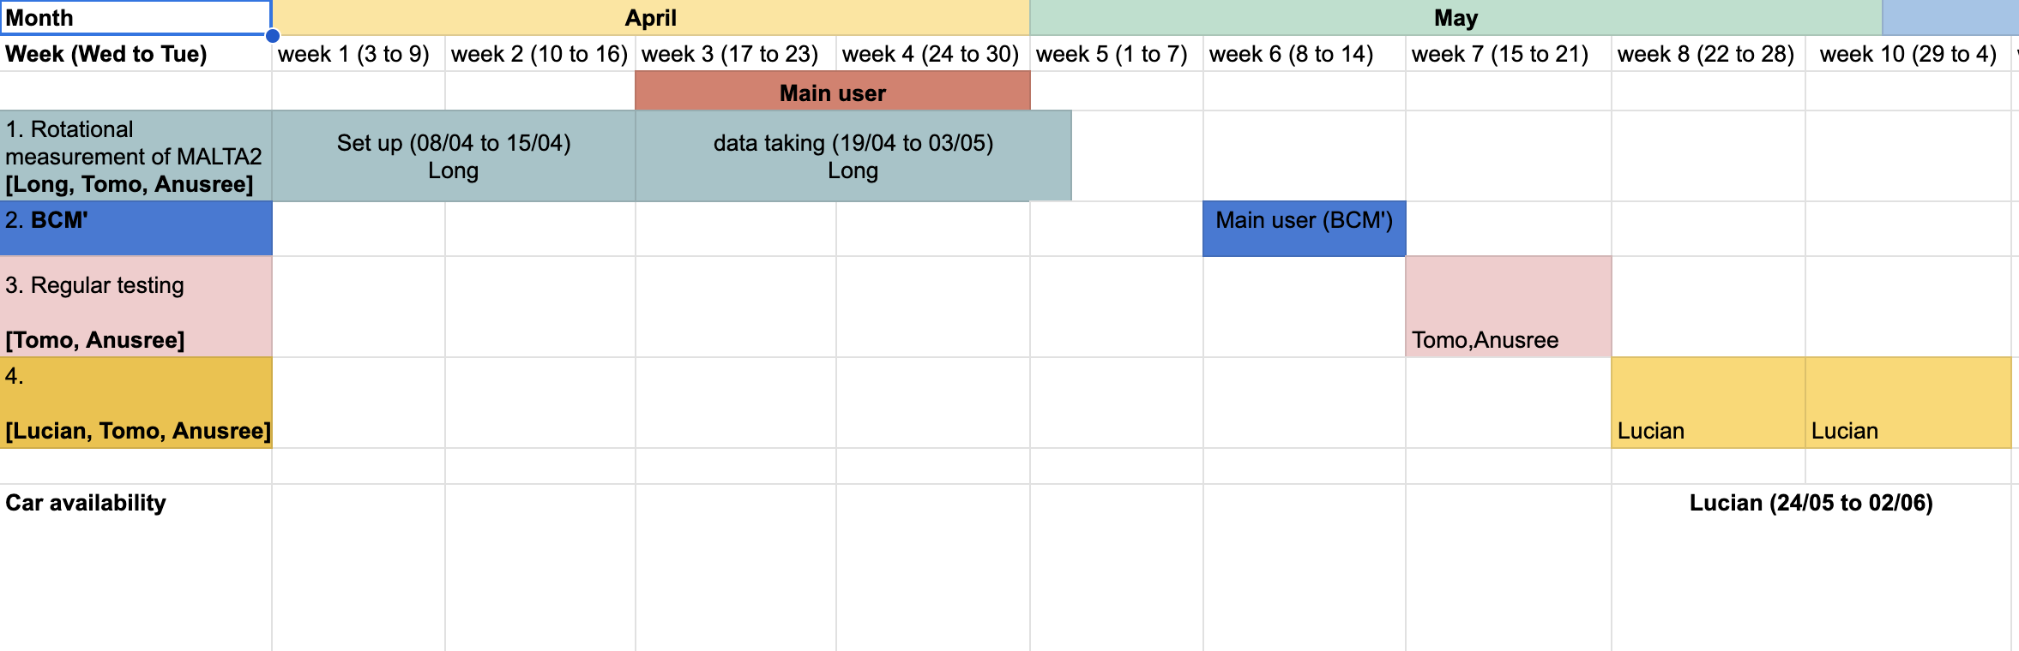
Test beam plan
- Telescope plane is calibrated for data taking
- Cold box Temperature/Humidity balance issue:
Humidity is decreased by introducing dry nitrogen, but the hot dry netrigen will warm up the cold box, hard to achieve -12C (planned working temperature)
Try to first cool down the box to -12 C, and then increase the nitrogen flux, and control the humidity in 20%, dew point temperature -30.3C, and take data from 15th-21st May. If BCM does not have plan, we have one week more.
Occupied by CERF, beam intensity(10^6 - 10^8) is too high for us to take data.
MALTA read-out & testing

Slide 20
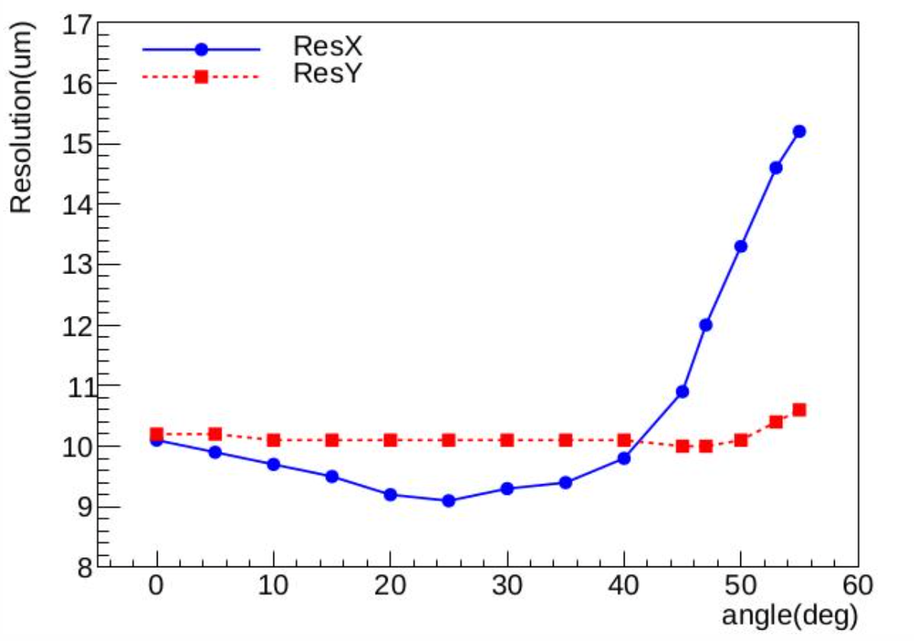
Before data taking: thoughts on rotational stage and DUT
start data taking
stop data taking
heat the coldbox
rotate the stage
cool the box down
DUT ON
sample W8R20
1.5hrs
2.5hrs
DUT OFF
0.5hrs
- For degree 25, will try to rotate the stage remotely with higher power of heater(now 25V, 5A, Maximum 30V), would be test on 15th May with Anusree.
- We need an extra access for degree 25 if remote control does not work, but we are not the main user.
For degree 0, 5, 10, 15 and 20:
- we can take data and change angle remotely.
- We should do it every 4-5 hours depending on data rate. 20-25 in total without issues. I would volunteer for the night time.
MALTA read-out & testing

Slide 21
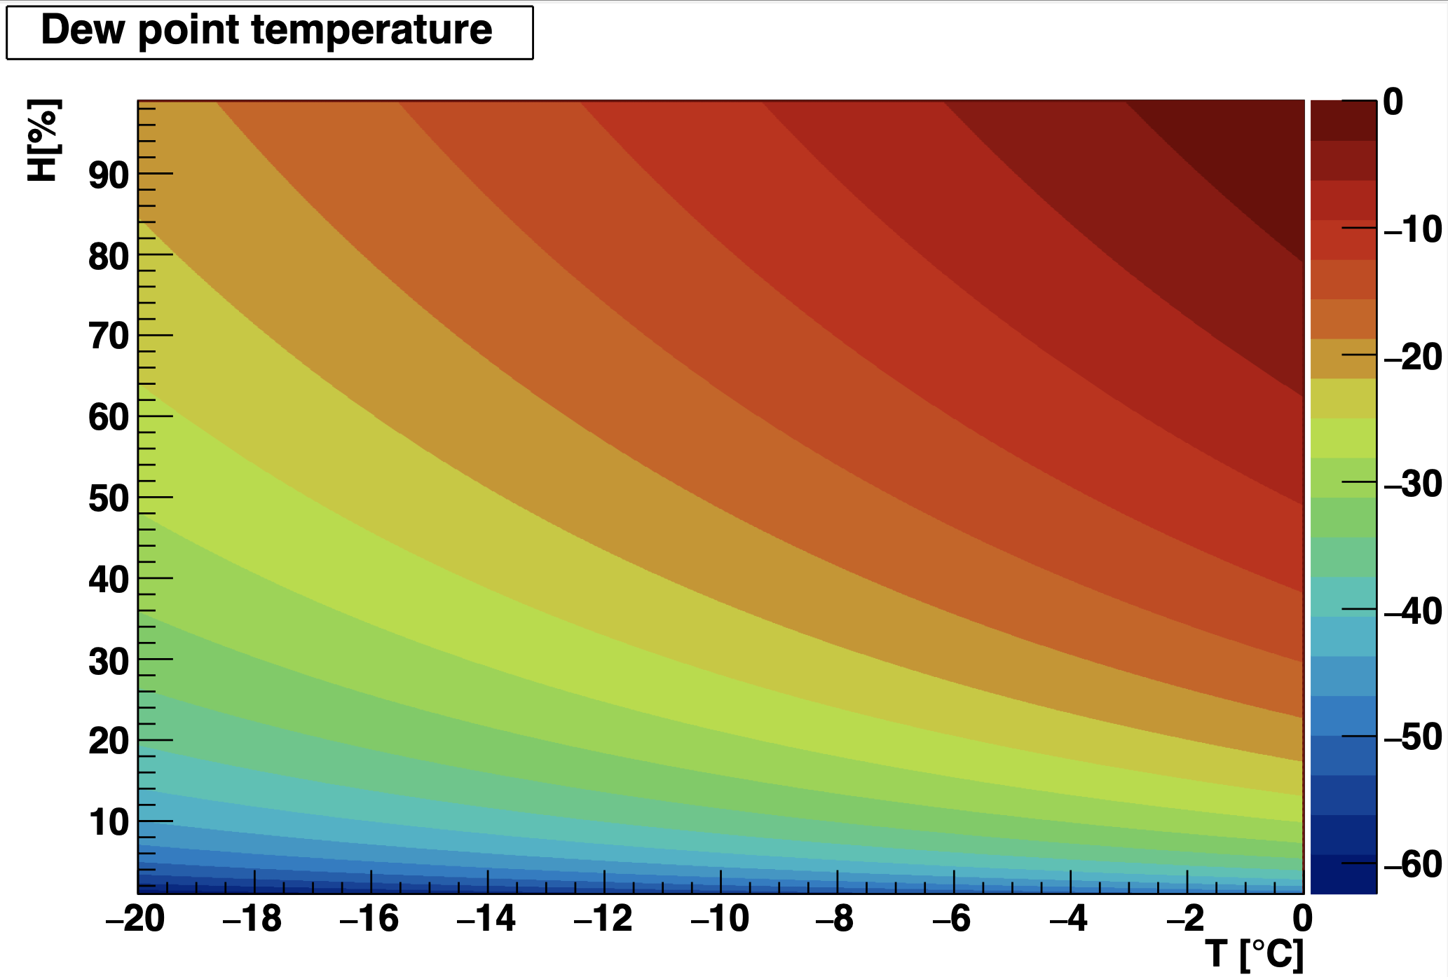
Before data taking: thoughts on safe T/H region
Safe T/H region for W12R7 data taking:
-12 C is hard to achieve, is -11 acceptable?
30% of Humidity seems to be safe just for condensing.
Any other reasons for humidity to be as lower as possible?
-11C/30% is confirmed to be ok to take data on Malta readout meeting 8th May.
MALTA read-out & testing

Slide 22
Further thoughts on the results obtained
- We have got some measurements on inclined angle study(30-60 deg)
- This could be applied to the depletion depth study.
- Shall we present them on a possible conference in the future? PIXEL2024 18-22 Nov. is a promising one
MALTA read-out & testing

Slide 23
Malta2 Test beam in May
Test setup
all other settings are by default.
operating temperature: -12C / room temperature for reference chip
relative humidity: < 40%
name | value
Vsub | 6, 9, 15, 20, 25, 30 [V]
ITHR | 15, 20, 40, 80, 120 [DAC]
Deg | 0, 5, 10, 15, 20, 25
Malta2 sensor
Technology: TJ-180
chip size: 20.2x10.1168 mm^2
Matrix: 224x512 pixels
pixel size: 36.4x36.4um^2
DUT sensor: W12R7
Cz back matelized
EDPW
thickness: 100 um
high doping n-layer
Irradiated 1E15 neq
Reference sensor: W11R0
Cz
EDPW
high doping n-layer
thickness 100um
MALTA read-out & testing

Slide 24
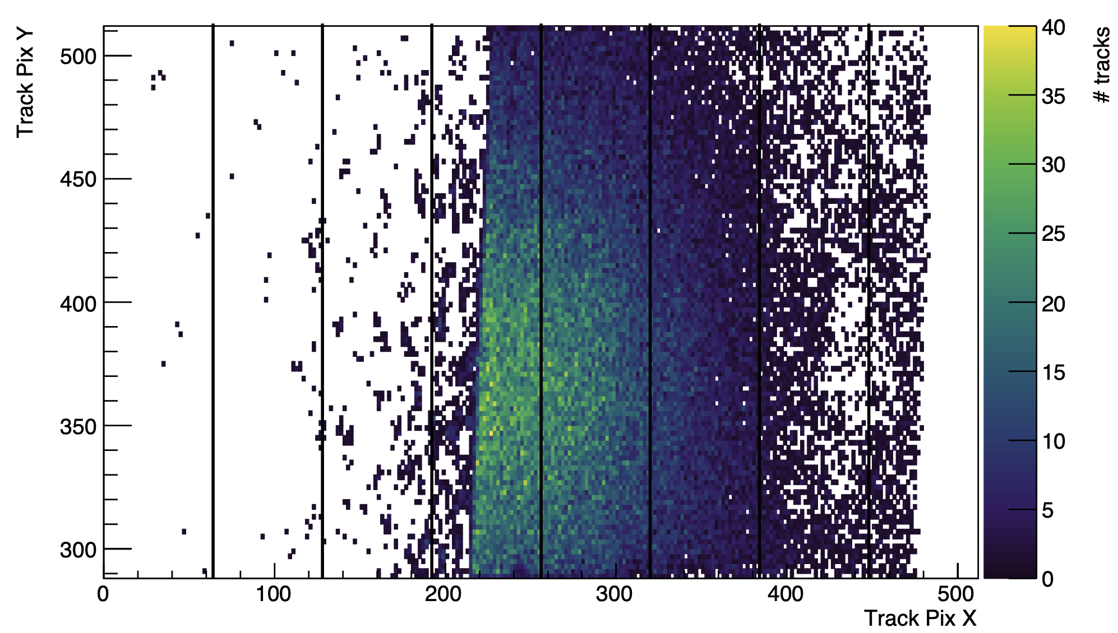
Malta2 test beam: Asymmetry again
The asymmetry hit on plane 3 occurred again.
trigger rate and hit position is affected
no effects on clsize, tracking efficiency, spatial resolution study
it affects the sector comparison
This issue seems to be related to the beam intensity(sensitive to high hit rate?), details not known yet.
Solution: move plane 3 a bit away from beam center.
MALTA read-out & testing

Slide 25
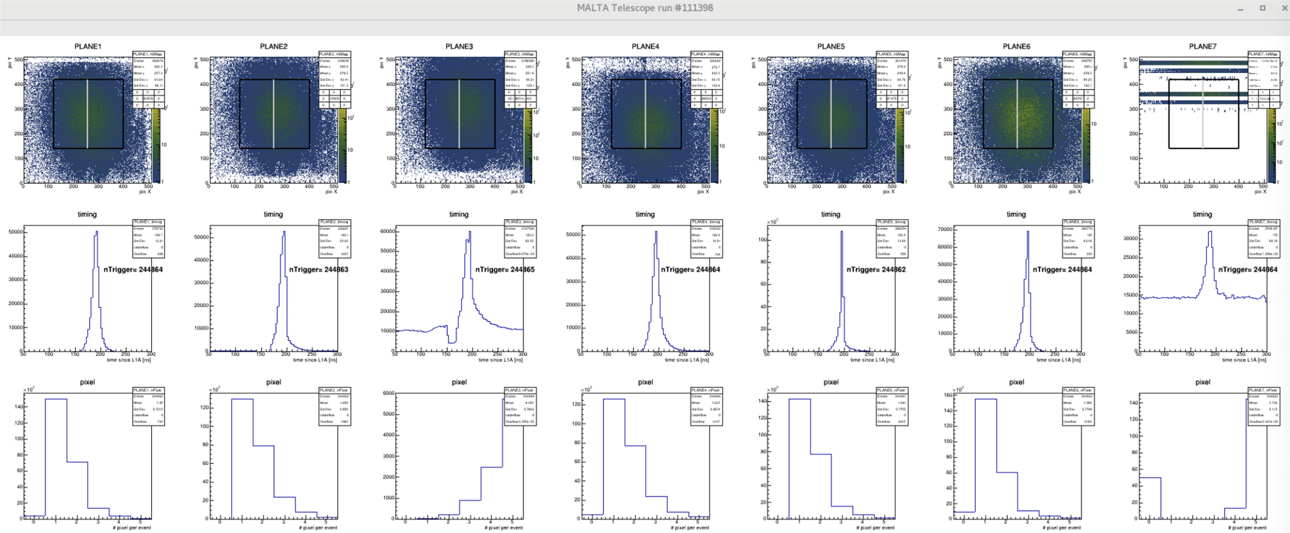
Malta2 test beam: abmormal hit map on DUT
Abnormal hit map on DUT
Occurred when ITHR set to be 120
Once it ran at ITHR120, hard to bring it back to normal. Not working to descrase the ITHR value
A tapcalibration run may be helpful.
Data taken ignoring ITHR120
MALTA read-out & testing

Slide 26
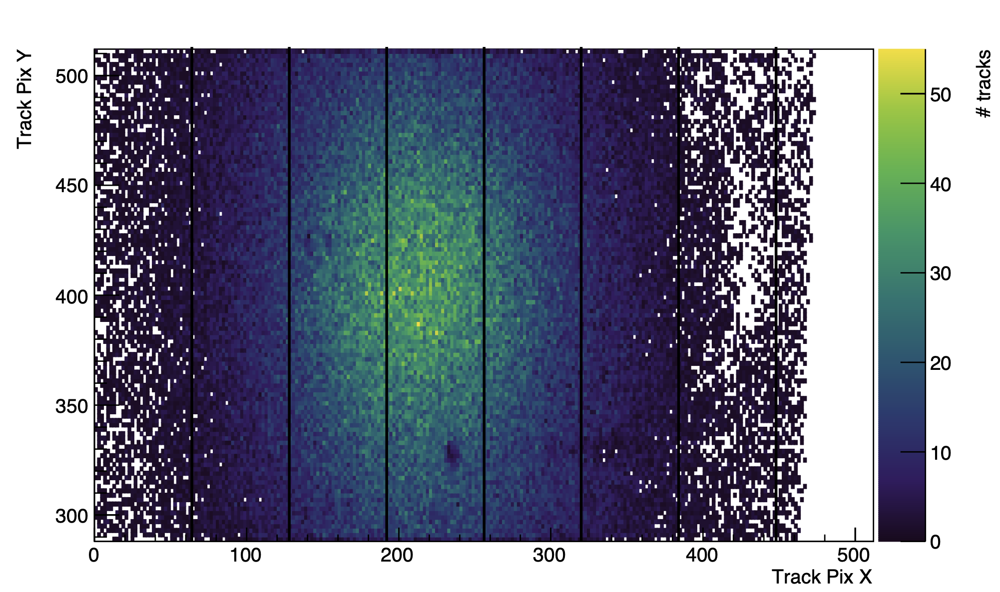
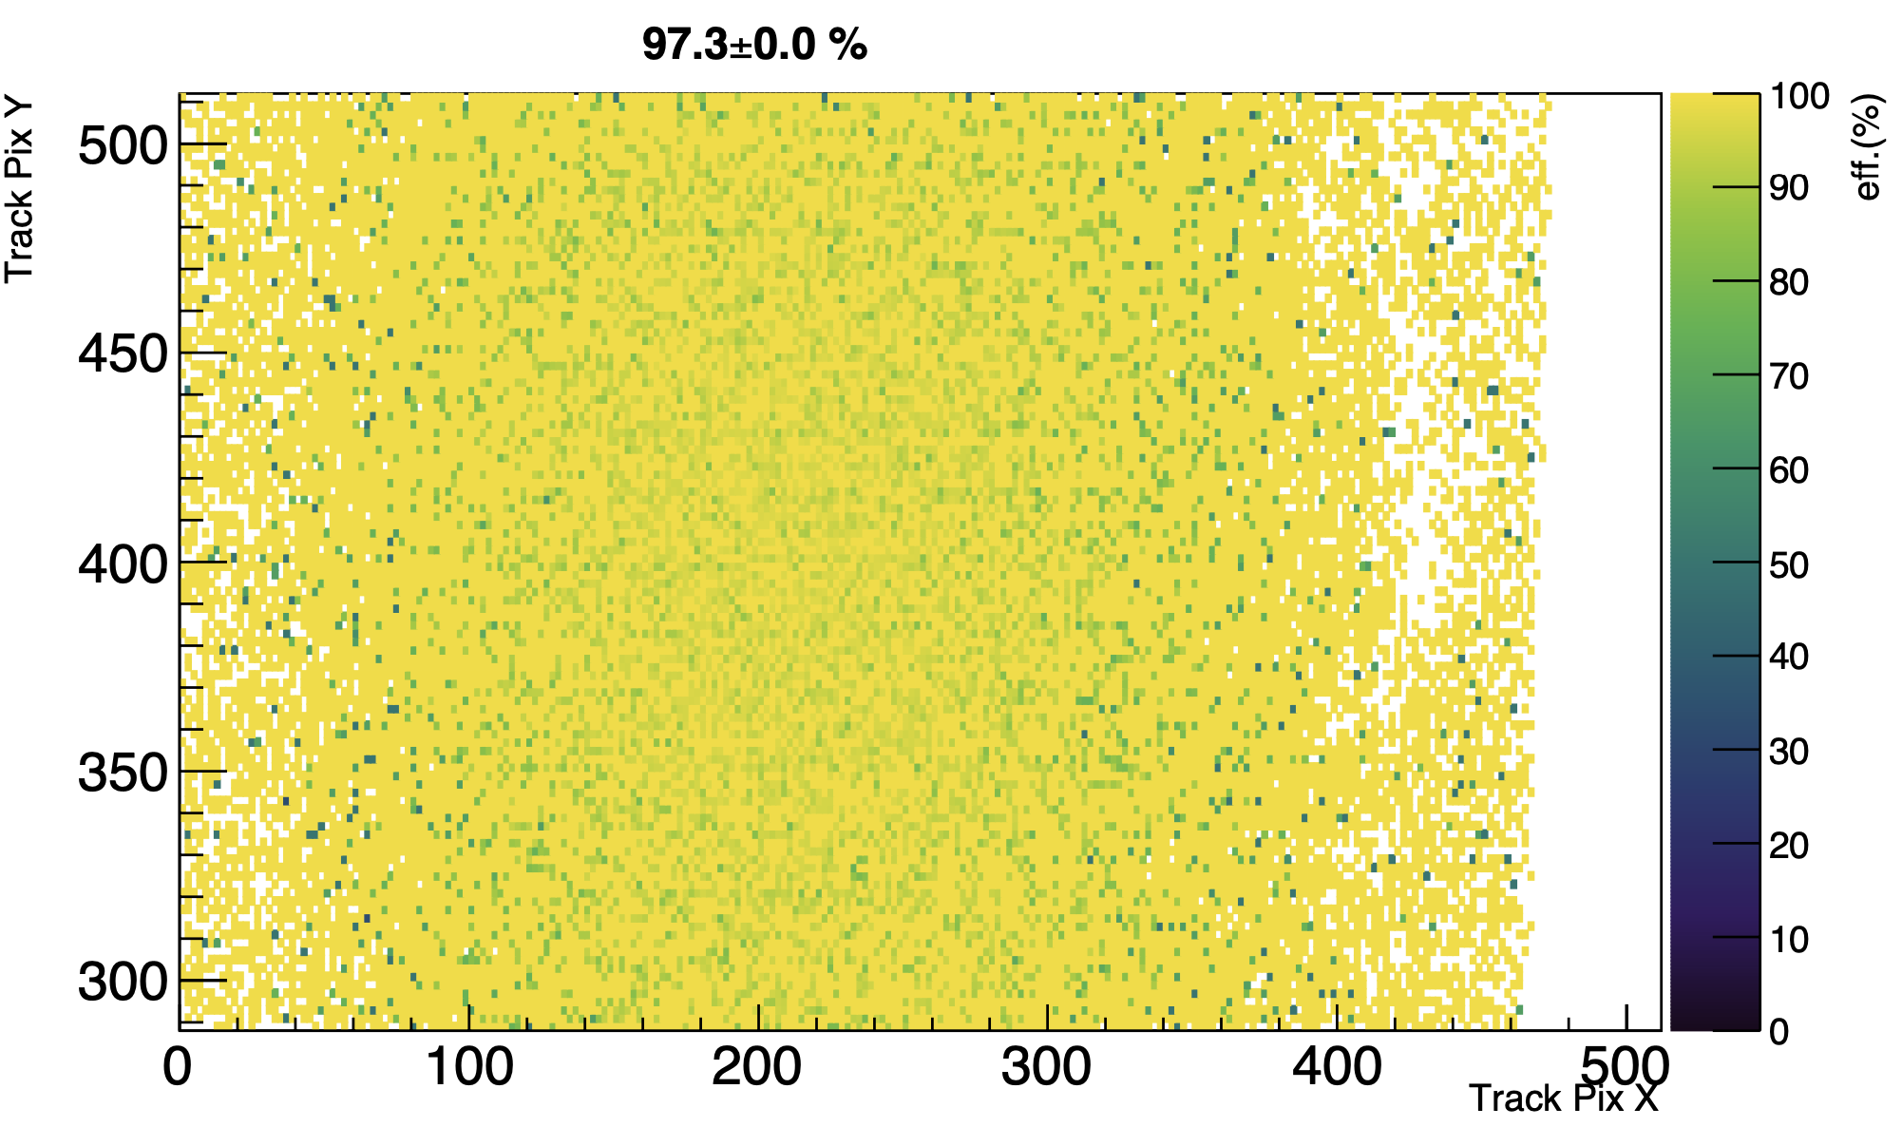
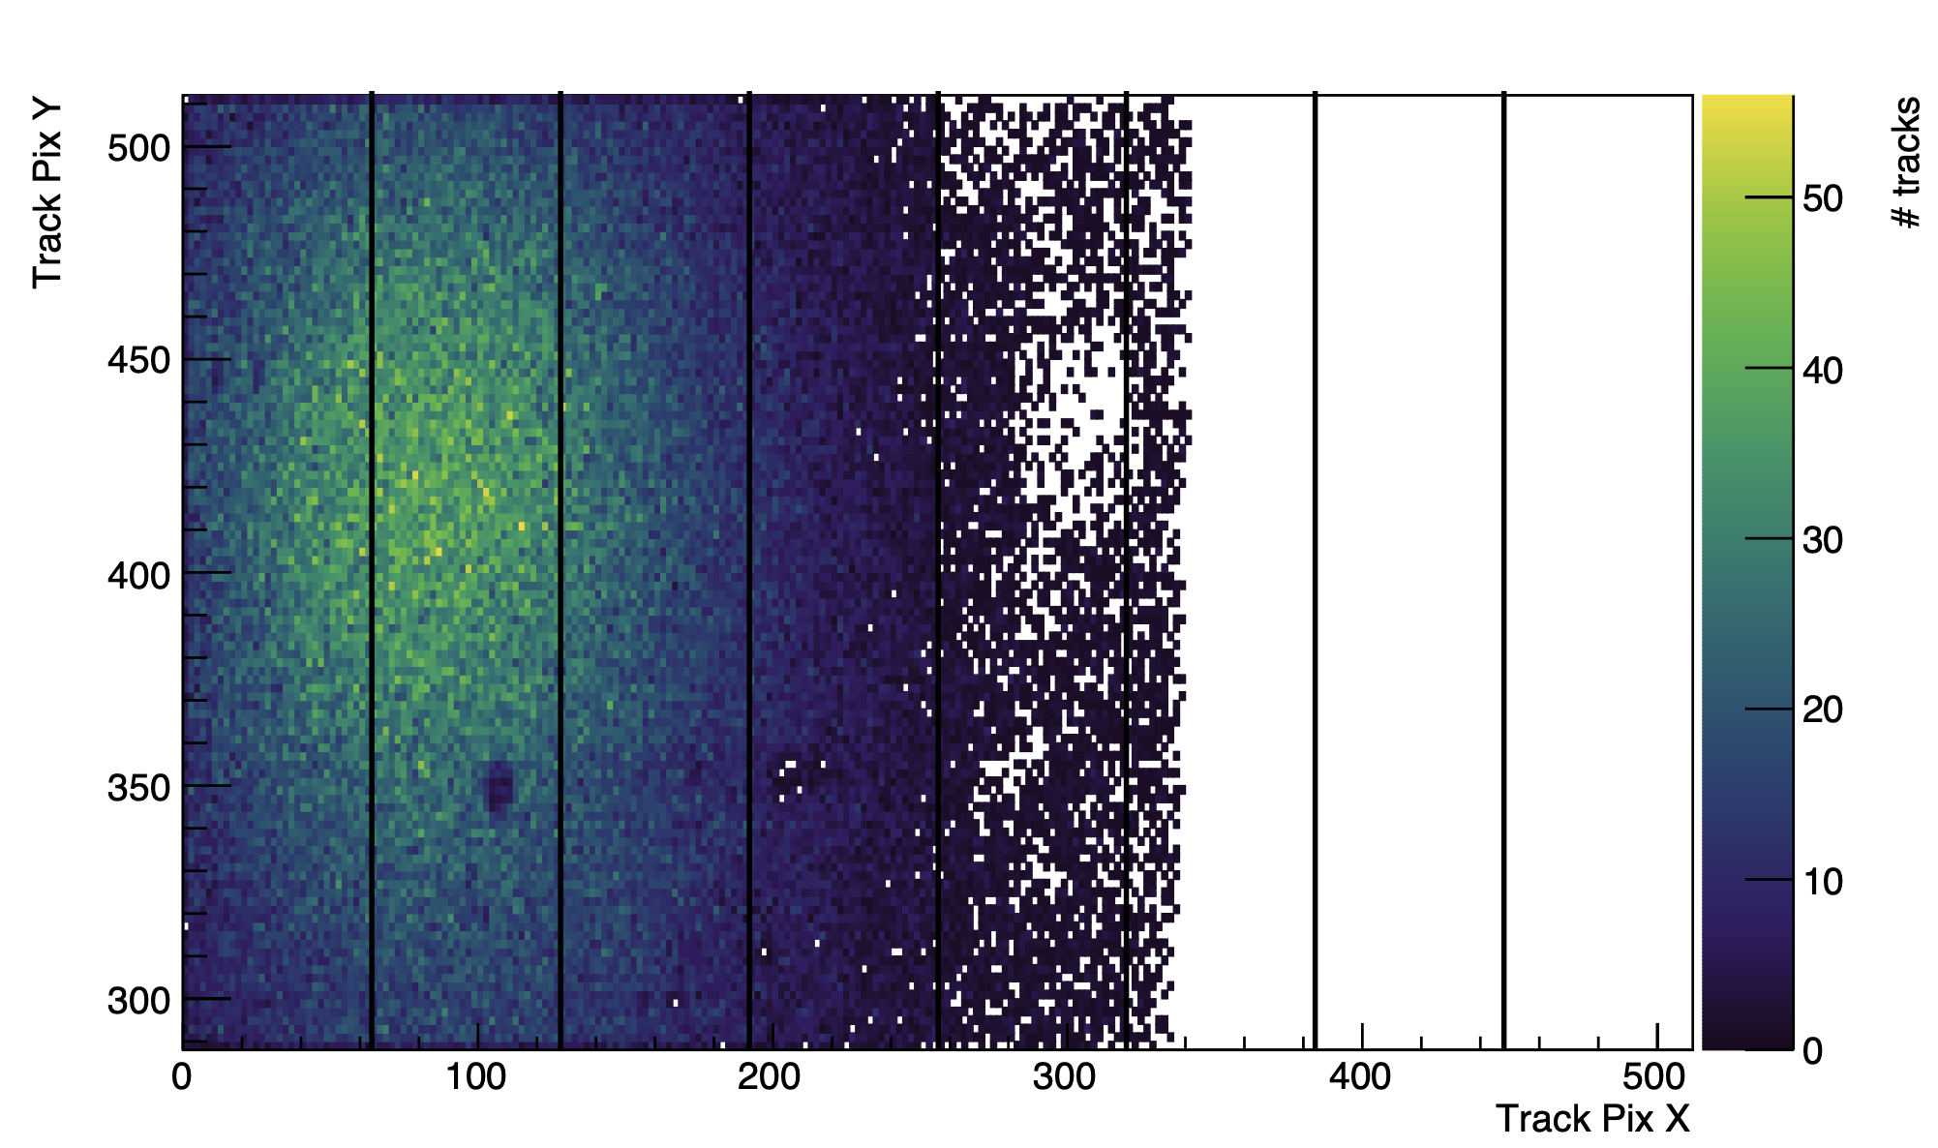
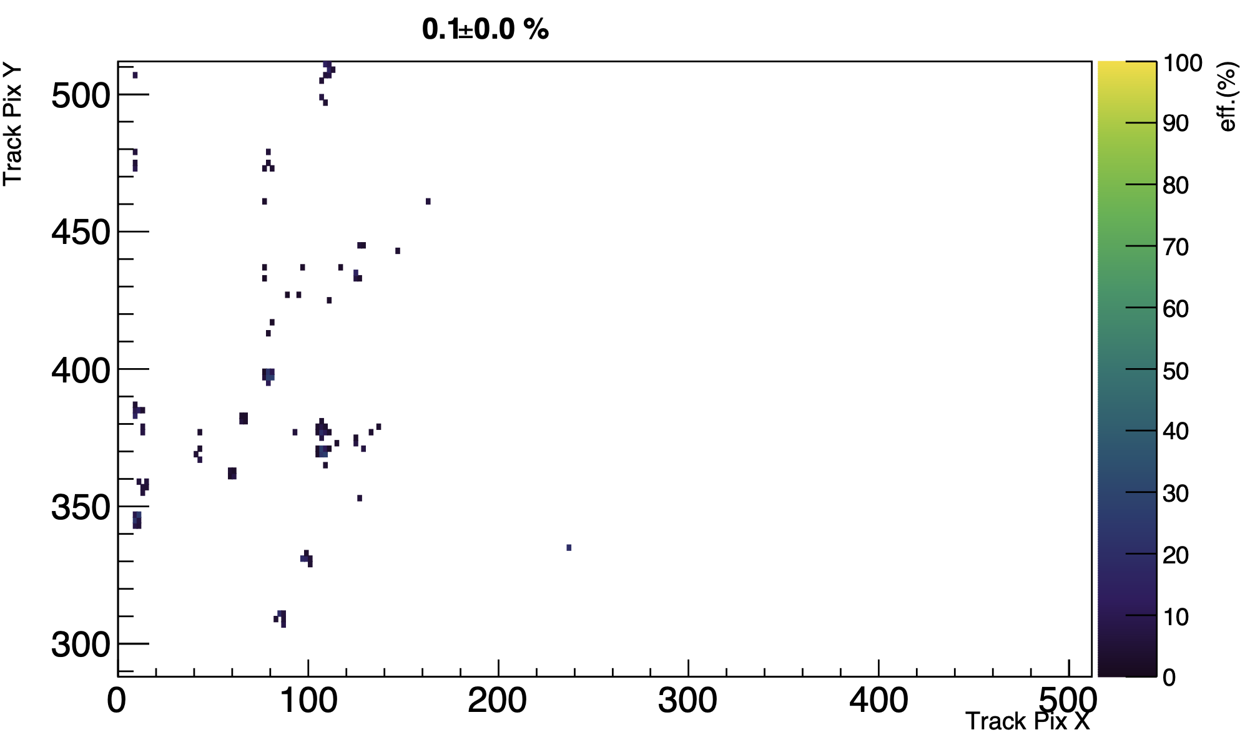
Summary of test beam W12R7
Track position
Angle [deg] | RunNo. | comments
0 | 8394-8423 | ITHR 15-120
5 | 8424-8453 | Asymmetry
 | 8593-8616 | ITHR 15-120
10 | 8454-8483 | abnormal hit map
 | 8484-8513 | ITHR 15-120
15 | 8521-8544 | ITHR 15-80
20 | 8545-8568 | ITHR 15-80
25 | 8569--8592 | ITHR 15-80
ITHR15, VSUB -25V, 0 deg
Eff 2D
ITHR120, VSUB -25V, 0 deg
MALTA read-out & testing

Slide 27
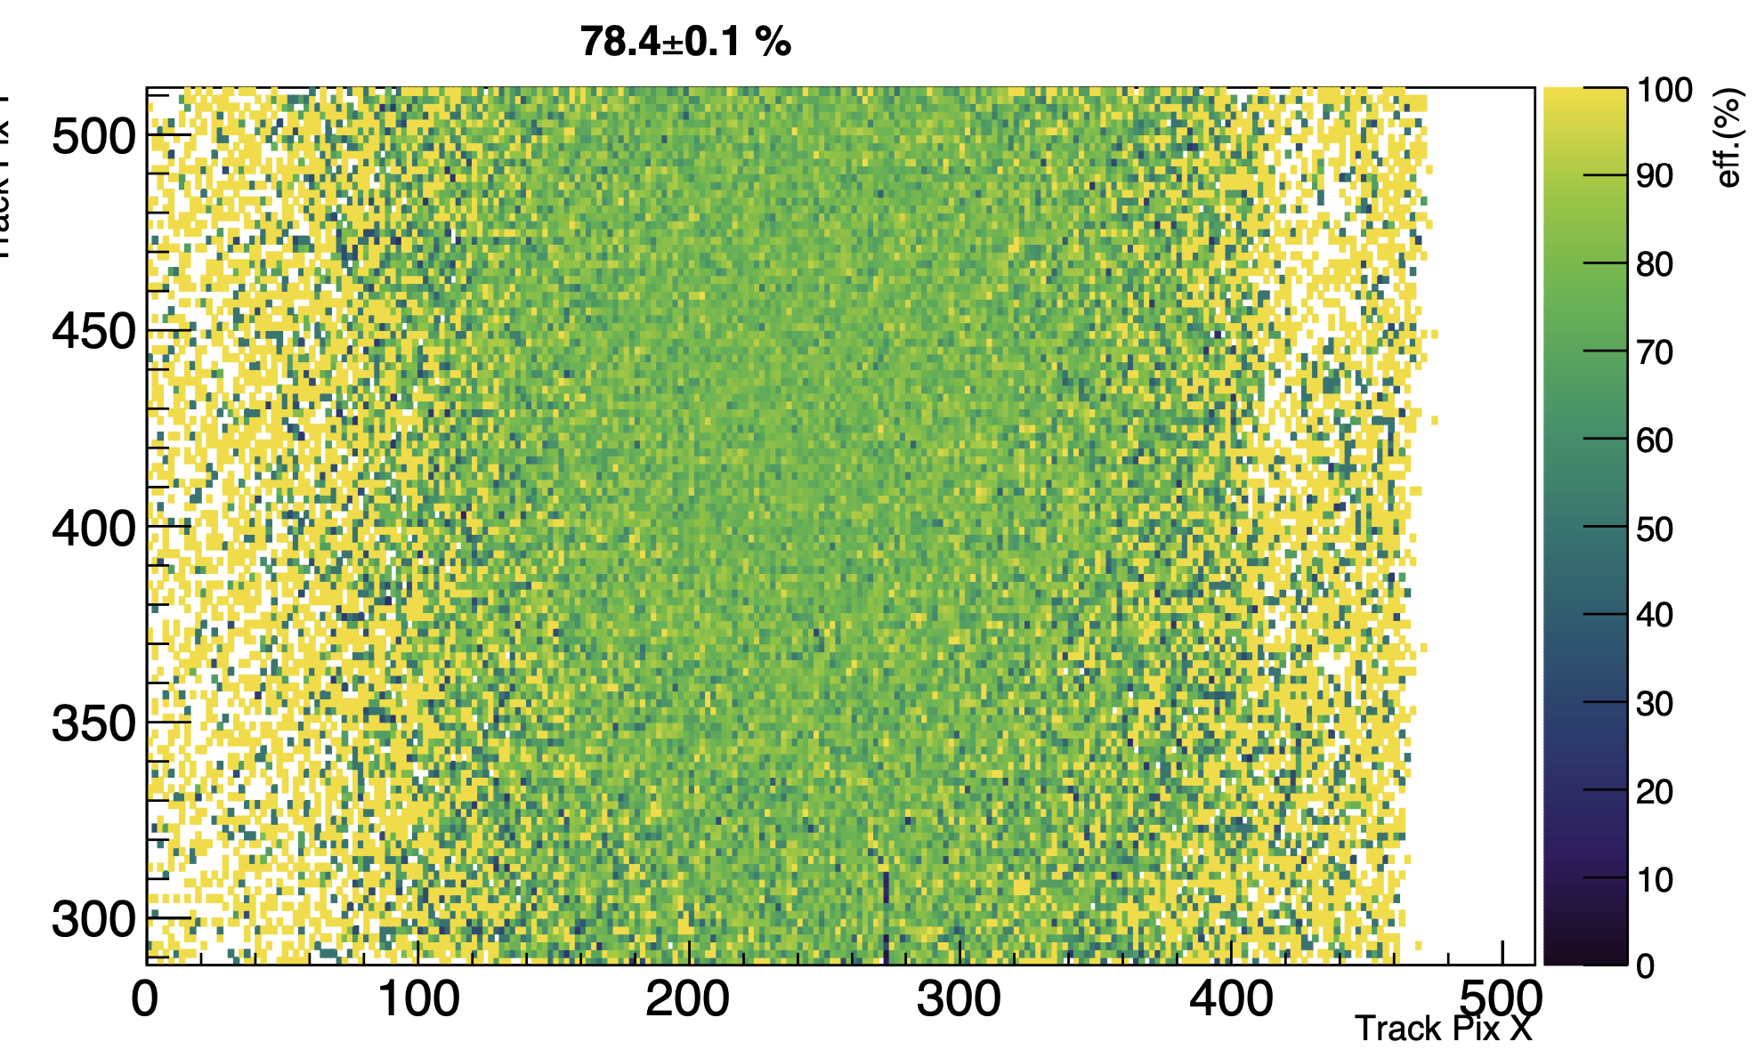
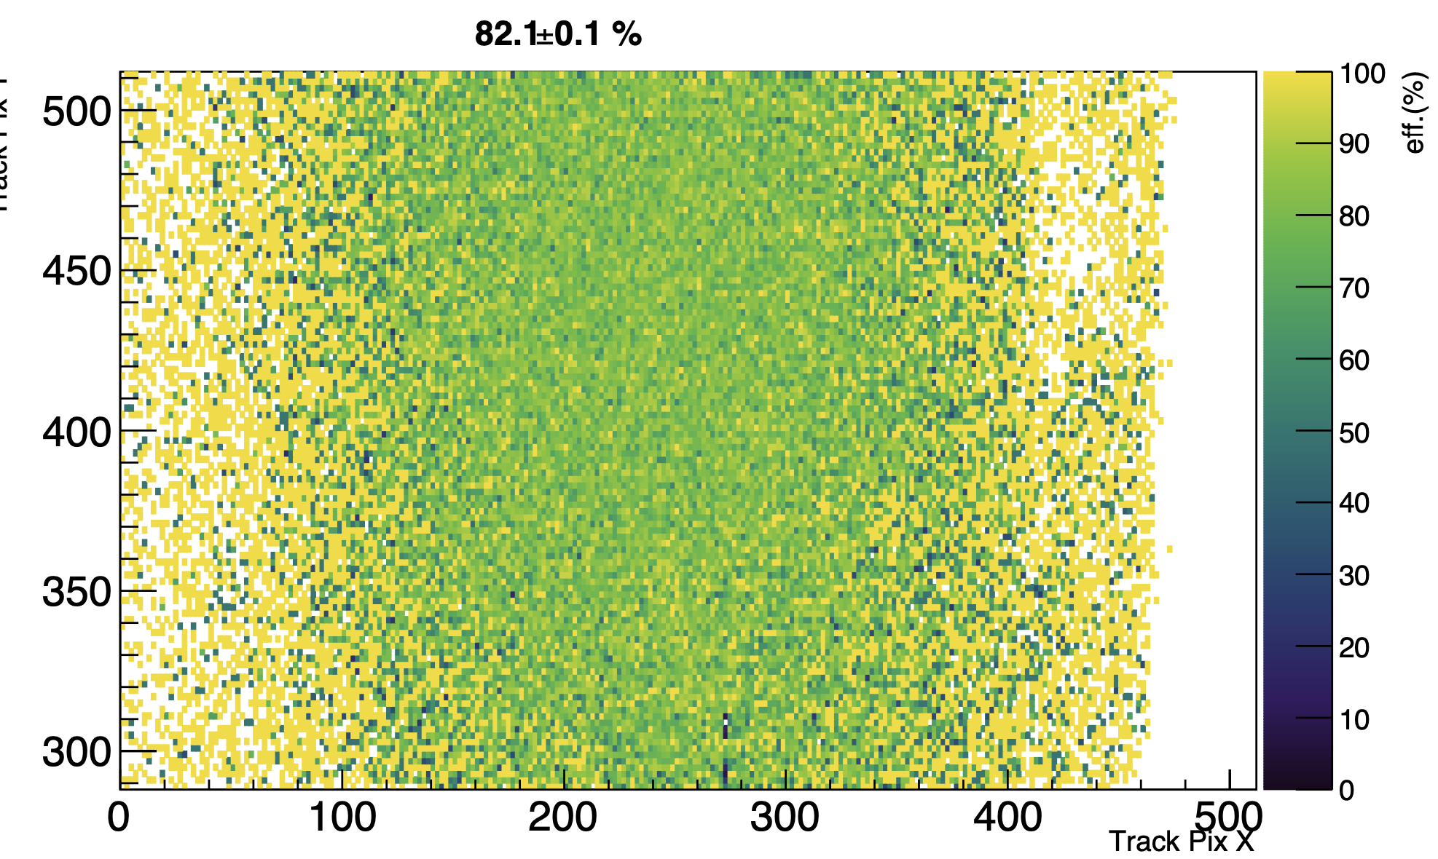
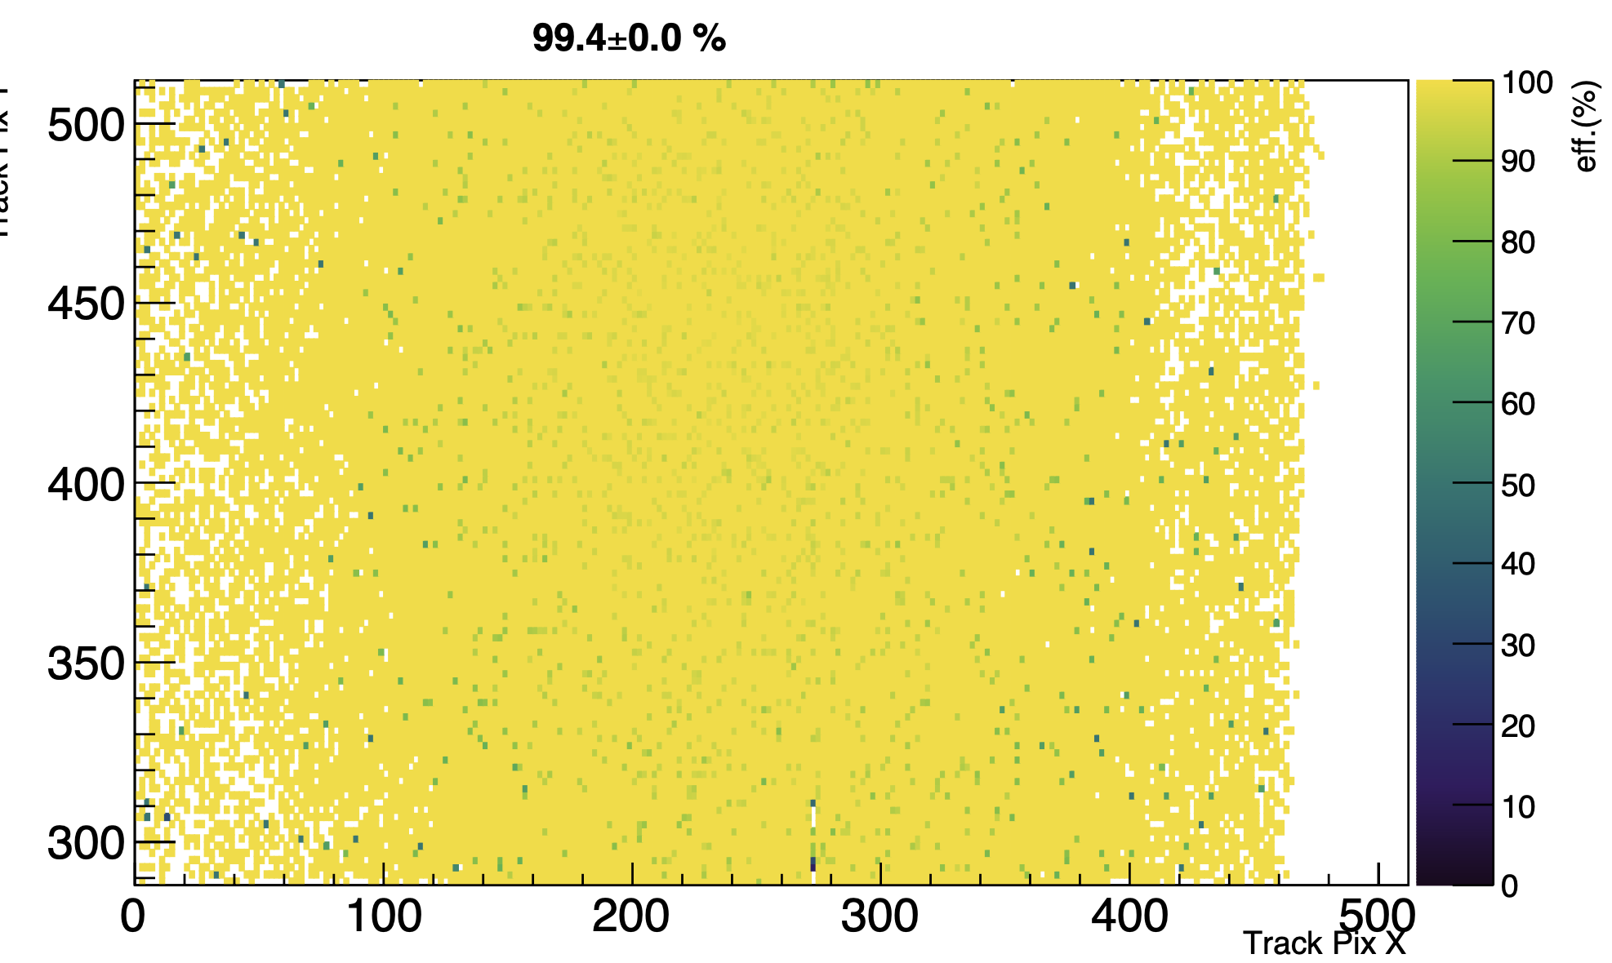

W11R0 test beam status
W11R0 will be tested from 0 to 60 deg with 5 deg as step, and ITHR from 15 to 120, at VSUB -6V:
- data taking done at 0 deg
- for Large angles, we need longer FMC cables, should implement it today after the meeting.
- Sometimes, I lose the control of PS12 from keyboard, not understood, should check today.
- 1.5hr needed for data taking at each angle, 17 hrs needed in total. Could be finished by Friday!
- Effiency increases as ITHR goes up, not understood.
ITHR 15
ITHR 20
ITHR 40
ITHR 80
MALTA read-out & testing

Slide 28

W11R0 test beam
Extended the FMC cables for rotation consideration.
Maybe signal degradations, not detected.
- FIFO overflowing at high beam intensity of 6e6(was 1.5e5)
- Solution: lower the trigger rate from 10K to 6K
MALTA read-out & testing

Slide 29



Depletion depth estimation using grazing angle methods
Should Verify the grazing angle method with non-irradiated sample, which is under measurements now.
Nuclear Inst. and Methods in Physics Research, A 1063 (2024) 169262
MALTA read-out & testing

Slide 30

Malta2 test beam: Hit issues on plane 3
More pixels on plane3 masked after xrayplotting.
Timing distribtion improved a lot, though plateau and tail still exist.
MALTA read-out & testing

Slide 31


Efficiency comparison
For Non-irradiated sample(W11R0), almost 100% Eff. shows sufficient depletion depth for charge collection.
The dcrease of the Eff at lower inclined angles indicates the degradation of depletion depth.
MALTA read-out & testing

Slide 32




Cluster size comparison
The decreased cluster size at -6V, shows a degradation in depletion deption.
For Irradiated sensor(W12R7), A sharper increase shown from 25 to 30 deg when Vsub < -9V.
Little changes in Y direction are expected.
X
Y
MALTA read-out & testing

Slide 33




Comparison of residual distribution
Decrease of RMS_residual in X axis was observed both in W12R7(10-30 deg)
rapid decrease from 25-30 deg in W12R7 sample. Should be checked.
Slight decrease in Y axis, more complex in W12R7.
MALTA read-out & testing

Slide 34
Defination of ‘MAll’ and ‘MPass’
Malta reference plane
Malta2 fiducial volume
Malta2 non-fiducial volume
Selected as MAll
Intercepts on planes
MPass selection
Dropped
extrapolated hit
passed closest cluster center
dropped closest cluster center
MAll decreases with inclined angle increasing, since transverse plane is reduced.
MALTA read-out & testing

Slide 35




Data quality check: Event number
MALTA read-out & testing

Slide 36


Depletion depth estimation using grazing angle method
MALTA read-out & testing

Slide 37


MaltaTbAnalysis software check
Soft ver. 2023
Soft ver. 2024
Analysis results are consistent with different soft version.
MALTA read-out & testing

Slide 38






Hit check on plane 3
Before masking, trigger No. 2M
After masking, trigger No. 1M
Abnormal timing & hit position in X axis distribution found in plane 3 before masking
This issue can be solved by masking noise pixels(maybe save reason for the 2D hitmap asymmetry)
Plane3 was used for triggering the readout of DUT, so the raw data was affected by noisy pixels in plane 3, disable palne 3 in track reconstruction will not be helpful.
Try to find chances to complete the data taking of W12R7.
MALTA read-out & testing

Slide 39
Depletion depth study using grazing angle method (1D)
p
α
A typical degradation of sensor performance after irradiation is the decrease of the depletion depth. This could be studied by inclined track at SPS using 180 GeV hadron.
d
cluster size projected on the axis perpendicular to the axis of rotation
d = p(clsizealpha - clsize0)/tanalpha
$${ClSize}_{⊥}(tanα)=\frac{d}{p}tanα + ClSize(0)$$
MALTA read-out & testing

Slide 40
Depletion depth estimation using grazing angle methods
Nuclear Inst. and Methods in Physics Research, A 1063 (2024) 169262
MALTA read-out & testing

Slide 41



Depletion depth estimation using grazing angle methods (2D)
Pixel silicon detectors for tracking particles in space
MALTA read-out & testing

Slide 42



1D vs. 2D
1D
2D
In 2D method, the depletion depth is underestimated by the small size of the cluster.
MALTA read-out & testing

Slide 43

Depletion depth estimation for W11R0
MALTA read-out & testing

Slide 44

Summary and outlook
Data taking for W12R7 was affected by noisy pixels on plane 3
Data can not be used for track reconstruction
Malta people agree that plane 3 works well after I masked noisy pixels(almost right half) on plane 3.
No criteria for telescope condition check, try to make a technical report from:
Compliance
tapcalibration run(software issue, not solved)
noise level
alignment
timing/efficiency/cluster info in manual run
triggering shceme
No beam form 12th June - 15th June, chance to install rotation stage and test again
To understand the depleth_depth vs. grazing angle, and the large spreads of the cluster size of W11R0.
MALTA read-out & testing

Slide 45

Validation of the telescope planes: Power & communication
Communication
Flash bit file to FPGA board according to address
Bit file info
Different configures between Malta2 and BCM?
Tap SW2 on FPGA board to start link
Power
name | value
AVDD[V] | 1.8, 0.9V for compliance
DVDD[V] | 1.8, 1.2 for complicance
SUB[V] | 6, 12 for plane 3(also for plane 4?)
PWell[V] | 6
Issues or not confirmed
MALTA read-out & testing

Slide 46
Validation of the telescope planes: Plane alignment
To what extent, the alignment is good enough (and criteria)
Useful tips:
Large linear stage - telescope plane
Move beam to the right -> lower the stage -> decrease ay
Move beam upwards -> move the stage towards FPGA -> increase ax
Currently, (151, 344) MoveIselLinearStage.py to check
Never move the stage remotely, and move it with a large step(cause crush)
Small linear stage - DUT
Move beam to the right -> lower the stage -> decrease Z(min 0.7)
In Z direction, mm in program, cm in the real world.
Move beam upwards -> Move the stage towards Wall -> Decrease Z(-11mm for maximum) need check
FPGA
Linear stage
Wall
MALTA read-out & testing

Slide 47
Validation of the telescope planes: Software
NOK
Masking
OK
TapCalib
Noise run
NOK
OK
?
Manual run with Beam
OK
AutomaticRun
Criteria?
Masking
OK
Noise
XrayPlotting
Analysis on PS16
MALTA read-out & testing

Slide 48

Data taking for W12R7 at 0 deg
Low quality happened at higher VSUB and lower ITHR(ITHR 20 especially)
MALTA read-out & testing

Slide 49


Data quality check for W12R7
Good run (IDB120 ITH80 SUB20)
Bad run (IDB120 ITH20 SUB20)
MALTA read-out & testing

Slide 50
Summary & next step
Low Data Quality at Higher Vsub(>= 15V) and lower ITHR(<= 20 DAC)
Efficiency drops to 0 after some run time.
Could be related to the noisy pixels.
No more noisy pixels were found in the noise scan.
Should check when the beam is back
Coldbox did not work
The motor of the cooling fan was broken
No spare one, waiting for the new one
Sample (W12R7) is store in 887-r-c37
Try to install fan and sample and take data
Next step
Vsub/ITHR scan for W12R7 with beam on
Masking extra noisy pixels and make comparison with previous measurements
Data taking for W12R7
For offline reconstruction, hard to do the rec ignoring plane 3. Complicated to implement in the source code.
MALTA read-out & testing

Slide 51
Test beam status
We got cooling issues with fan not working last weeks(replaced with new one).
Power supply issues were observed last night
Power ON/OFF seems to be ok form the output info.
The monitoring of the PSUs(not serial port issues, just no reponse to a quest)
An access should be taken to check the PSU, and cycle them manually.
To-do
VSUB/ITHR scan for W12R7 sample to mask more noisy pixel
monitoring the PSU during the data taking to verify the compliance for the Eff. droping issue.
Shall we test the 3e15 irradiated samples after W12R7?
W12R7(Cz, XDPW,100um, H-dop, Back-metalised, 1e15)
W18R19(Cz, XDPW, 100um, VH-dop, Back-metalised, 3e15)
MALTA read-out & testing

Slide 52


FMC connection issues
Abormal behaviour of DUT observed in manual
Bad tap calibration results were also observed
This is due to bad connection of FMC after rotation.
MALTA read-out & testing

Slide 53

Data taking for W12R7 at 0 deg
Low quality was also oberved:
VSUB: -6V, ITHR 80, 10 deg
No more noisy pixel found.
May be caused by compliance, but can not monitor PSU all the time.
Serial port busy
No always happen.
MALTA read-out & testing

Slide 54


Data quality check for W12R7, same configuration
run_10703
run_10727
MALTA read-out & testing

Slide 55



Efficiency Comparison
Low efficiency at 15 deg is observed.
This is due to the FMC connection issue.
Data token again
MALTA read-out & testing

Slide 56


Efficiency Comparison
MALTA read-out & testing

Slide 57


Cluster size comparison
X
Y
MALTA read-out & testing

Slide 58


Spatial resolution comparison
X
Y
MALTA read-out & testing

Slide 59



Estimation of the depletion depth using grazing angle method
p
α
d
cluster size projected on the axis perpendicular to the axis of rotation
$${ClSize}_{⊥}(α)=\frac{d}{p}tanα + ClSize(0)$$
MALTA read-out & testing

Slide 60
Cluster size comparison
MALTA read-out & testing

Slide 61


Clsize comparison
Before masking
After masking
X
Y
MALTA read-out & testing

Slide 62


Spatial resolution comparison
Before masking
After masking
X
Y
MALTA read-out & testing

Slide 63
BACK UP
MALTA read-out & testing

Slide 64

Malta telescope
30-60 deg
Scint.
L1A
MALTA read-out & testing

Slide 65
DUT info
Test setup
all other settings are by default.
operating temperature: -12~-15C
relative humidity: < 1%
name | value
Vsub | 6, 9, 15, 20, 25, 30 [V]
ITHR | 15, 20, 40, 80, 120 [pA]
Deg | 30, 35, 40, 45, 50, 55, 60
Malta2 sensor
Technology: TJ-180
chip size: 20.2x10.1168 mm^2
Matrix: 224x512 pixels
pixel size: 36.4x36.4um^2
DUT sensor: W12R7
Cz back matelized
thickness: 300 um
Irradiated 1E15 neq
ITHR SUB DEG
015 20.0 60.0
015 25.0 60.0
015 30.0 60.0
020 25.0 60.0
020 30.0 60.0
040 25.0 60.0
040 30.0 60.0
080 25.0 60.0
080 30.0 60.0
120 25.0 60.0
120 30.0 60.0
11 data point missed during
data taking
MALTA read-out & testing

Slide 66
Geometry configuration
MALTA read-out & testing

Slide 67



Malta Ttigger logic unit
Malta_TLU_GUI
Triggering planes
Level 1 accept(L1A)
MALTA read-out & testing

Slide 68
Test beam support
- Beam monitor
- twiki
- beam quality
- data monitor
- PDU
MALTA read-out & testing

